Slide 1
Hello Year 10.
Title: Moles
Get your exercise book out.
Sit down.
Put your planner on orange.
Silently read.
Connect

Slide 2
Hello Year 10. Date and title into your book please. Do now! Match up the question to the answer.
Title: Moles
Connect
Give the common name for group 1.
Describe the trend in reactivity as you go down group 1.
How is this different to group 7?
True or false – Transition metals are found in group 2.
State a property of group 8 elements.
Unreactive, also have a full outer shell
Become more reactive as you go down the group
False – They are the middle section
They become less reactive as you go down the group.
Alkali metals

Slide 3
Hello Year 10. Date and title into your book please.
Title: Moles
Connect
Give the common name for group 1.
Describe the trend in reactivity as you go down group 1.
How is this different to group 7?
True or false – Transition metals are found in group 2.
State a property of group 8 elements.

Slide 4
Hello Year 10. Date and title into your book please.
Title: Moles
Connect
Give the common name for group 1. Alkali metals
Describe the trend in reactivity as you go down group 1. More reactive
How is this different to group 7? Group 7 becomes less reactive as you go down.
True or false – Transition metals are found in group 2. False – Found in middle block
State a property of group 8 elements. Unreactive, full outer shell

Slide 5
Specification

Slide 6
Mass, M_{r}, Moles
Calculate the number of moles in a substance
Recall the definition of a mole
1-3
Calculate the amount of moles of a substance from its mass in grams
4-5
Calculate the mass of a substance, given the amount in moles
6-8

Slide 7
Recall the definition of a mole (grade 1-3) Calculate the amount of moles of a substance from its mass in grams (grade 4-5) Calculate the mass of a substance, given the amount in moles (Grade 6-8)
New Info
The Mole is Scientists’ name for a standard amount of particles
A mole of any substance contains 6.02 x 10²³ particles
This number is known as Avogadro's constant

Slide 8
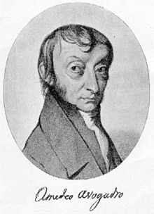
Recall the definition of a mole (grade 1-3) Calculate the amount of moles of a substance from its mass in grams (grade 4-5) Calculate the mass of a substance, given the amount in moles (Grade 6-8)
New Info
The number of particles in one mole is called Avogadro’s Constant in honour of the famous Italian scientist Amadeo Avogadro
Avogadro’s Constant is 6.02 x 10²³
Or ... 602,000,000,000,000,000,000,000
Or ... Six hundred and two thousand, million, million, million
Amadeo
Avogadro 1776 - 1865

Slide 9
Know that the amount of a substance is measured in moles and is the relative formula mass in grams containing 6.02 × 1023 particles (grade 1-3) Calculate the amount of moles of a substance from its mass in grams (grade 4-5) Calculate the mass of a substance, given the amount in moles (Grade 6-8)
New Info

Slide 10
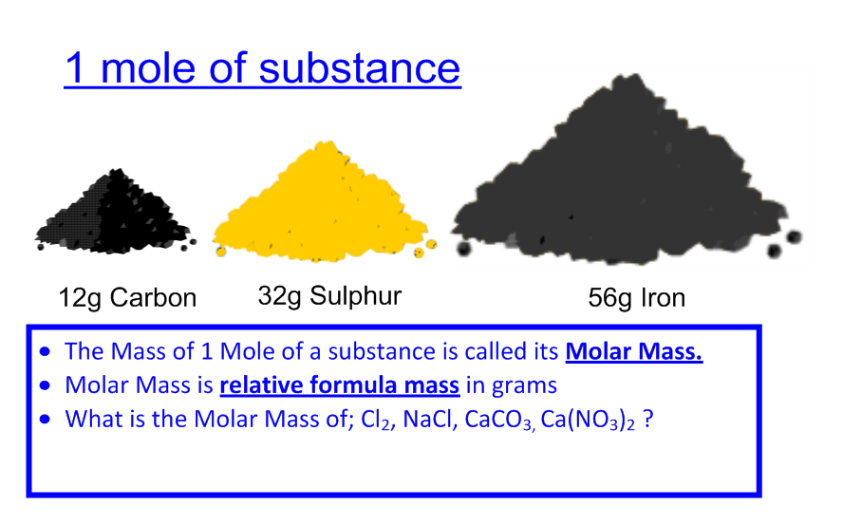
Recall the definition of a mole (grade 1-3) Calculate the amount of moles of a substance from its mass in grams (grade 4-5) Calculate the mass of a substance, given the amount in moles (Grade 6-8)
Activities
The mass of 1 mole of a substance in grams is the same as its relative formula mass.

Slide 11
Recall the definition of a mole (grade 1-3) Calculate the amount of moles of a substance from its mass in grams (grade 4-5) Calculate the mass of a substance, given the amount in moles (Grade 6-8)
Activities
H₂
Ne
H₂O
Cl₂
CO₂
HCl
NaOH
Mg
Pb
H₂SO₄
H₂ 2g
Ne 20g
H₂O 18g
Cl₂ 71g
CO₂ 44g
HCl 36.5g
NaOH 40g
Mg 24g
Pb 207g
H₂SO₄ 98g

Slide 12
Recall the definition of a mole (grade 1-3) Calculate the amount of moles of a substance from its mass in grams (grade 4-5) Calculate the mass of a substance, given the amount in moles (Grade 6-8)
Activities
To calculate the number of moles we need to know the mass and the M_{r} (Relative Formula mass):
Moles = Mass
M_{r}
Calculate the number of moles (to 2dp) in...
13g of Na
26g of Mg
46g of Ca

Slide 13
Recall the definition of a mole (grade 1-3) Calculate the amount of moles of a substance from its mass in grams (grade 4-5) Calculate the mass of a substance, given the amount in moles (Grade 6-8)
Activities
To calculate the mass of a substance when we know how many moles there are...
Mass = Moles x M_{r}
Calculate the mass of...
2 moles of Li
3.5 moles of C
0.3 moles of S

Slide 14
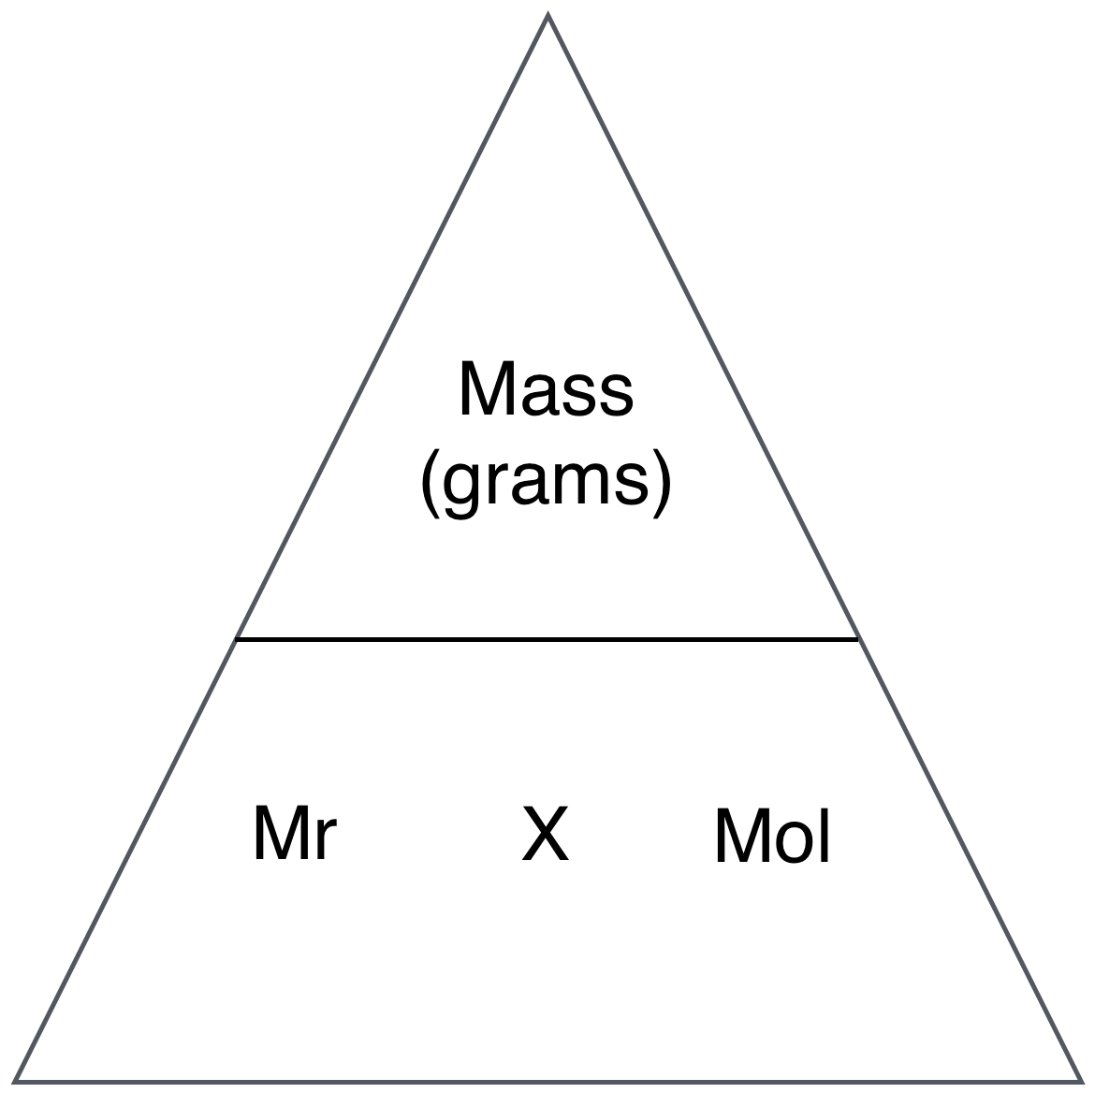
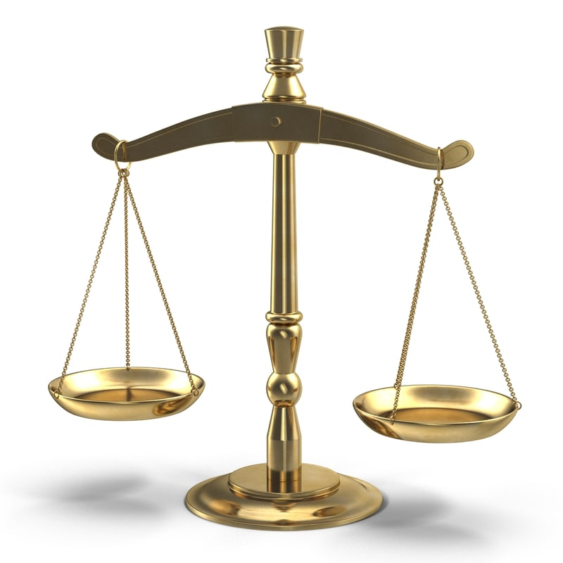
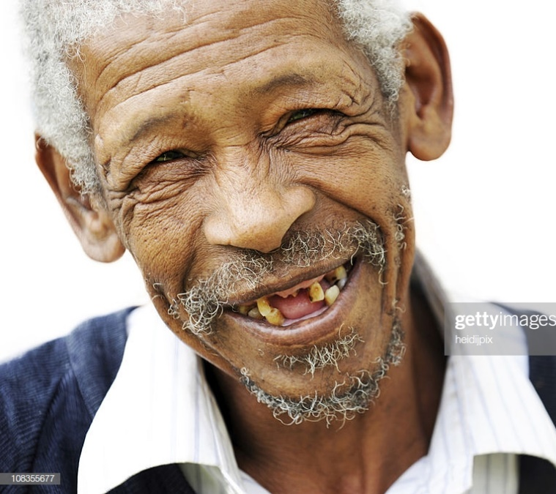
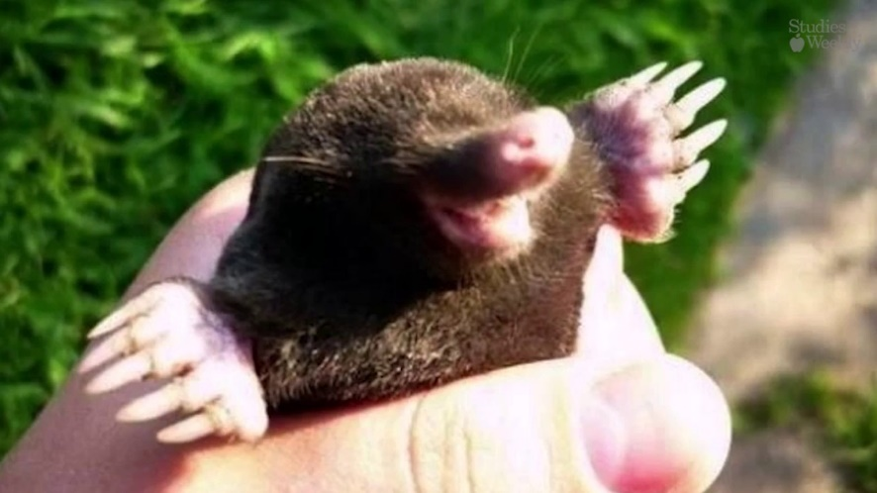
Recall the definition of a mole (grade 1-3) Calculate the amount of moles of a substance from its mass in grams (grade 4-5) Calculate the mass of a substance, given the amount in moles (Grade 6-8)
Activities

Slide 15
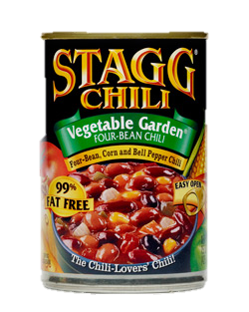
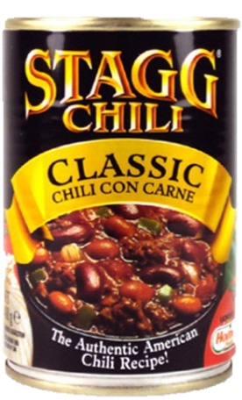
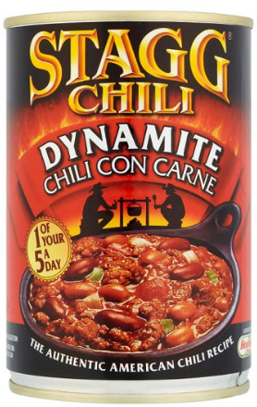
Demonstrate
Grade 1-3
Molecule | Br₂ | SO₂ | CO₂ | Mg(NO₃)₂
Mass of substance | 160 | 768
M_{r} (Relative formula mass) | 40 | 64 | 44 | 148
Calculation | 40 ÷ 160 | 768 ÷ 64 | 44 x 20 | 148 x 0.5
No. of Moles |  |  | 20 | 0.5
Grade 4-5
Grade 6-8

Slide 16
Demonstrate
Grade 1-3
Molecule | Br₂ | SO₂ | CO₂ | Mg(NO₃)₂
Mass of substance | 160 | 768 | 880 | 74
M_{r} (Relative formula mass) | 40 | 64 | 44 | 148
Calculation | 40 ÷ 160 | 768 ÷ 64 | 44 x 20 | 148 x 0.5
No. of Moles | 0.25 | 12 | 20 | 0.5
Grade 4-5
Grade 6-8

Slide 17
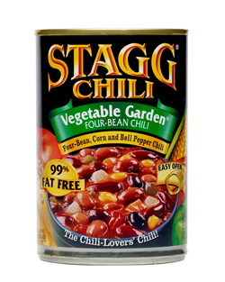
Demonstrate
Grade 1-3

Slide 18
Mass, M_{r}, Moles
Calculate the number of moles in a substance
Recall the definition of a mole
1-3
Calculate the amount of moles of a substance from its mass in grams
4-5
Calculate the mass of a substance, given the amount in moles
6-8

