Slide 1
https://www.northstarscienceschool.co.uk/the-peoples-picture/

Slide 2
What is involved:
https://www.northstarscienceschool.co.uk/student-registration/
Introduction – Video 1
Description of task – Video 2 (pause at stages to complete tasks)
Support for drawing – Video 3

Slide 3
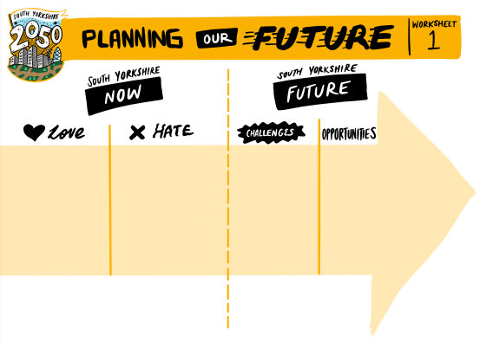

Slide 5
What you need to do now
You need to register yourselves at: https://wh1.snapsurveys.com/s.asp?k=160397740559
Make sure you complete all information as well as selecting Stocksbridge High school to be part of the events on the afternoons of 1, 2, 3 of December.
You need to submit a photo of your map as part of this registration process.

