Slide 1
Mark/ Level | A0 | Typical Features | ✔
Level 6 Convincing critical analysis and exploration 26 – 30 marks | A01 | Critical, exploratory, conceptualised response to task and whole text Judicious use of precise references to support interpretation(s)
 | A02 | Analysis of writer’s methods with subject terminology used judiciously Exploration of effects of writer’s methods to create meanings
 | A03 | Exploration of ideas/perspectives/contextual factors shown by specific, detailed links between context/text/task
Level 5 Thoughtful, developed consideration 21 – 25 marks | A01 | Thoughtful, developed response to task and whole text Apt references integrated into interpretation(s)
 | A02 | Examination of writer’s methods with subject terminology used effectively to support consideration of methods Examination of effects of writer’s methods to create meanings
 | A03 | Thoughtful consideration of ideas/perspectives/contextual factors shown by examination of detailed links between context/text/task
Level 4 Clear understanding 16 - 20 marks | A01 | Clear, explained response to task and whole text Effective use of references to support explanation
 | A02 | Clear explanation of writer’s methods with appropriate use of relevant subject terminology Understanding of effects of writer’s methods to create meanings
 | A03 | Clear understanding of ideas/perspectives/ contextual factors shown by specific links between context/text/task
Level 3 Explained, structured comments 11 - 15 marks | A01 | Some explained response to task and whole text References used to support a range of relevant comments
 | A02 | Explained/relevant comments on writer’s methods with some relevant use of subject terminology Identification of effects of writer’s methods to create meanings
 | A03 | Some understanding of implicit ideas/ perspectives/contextual factors shown by links between context/text/task
Level 2 Supported, relevant comments 6 – 10 marks | A01 | Supported response to task and text Comments on references
 | A02 | Identification of writers’ methods Some reference to subject terminology
 | A03 | Some awareness of implicit ideas/contextual factors
Level 1 Simple, explicit comments 1 – 5 marks | A01 | Simple comments relevant to task and text Reference to relevant details
 | A02 | Awareness of writer making deliberate choices Possible reference to subject terminology
 | A03 | Simple comments on explicit ideas/ contextual factors
0 marks | Nothing worthy of credit/ nothing written

Slide 3
Romeo and Juliet revision
AIM: To revise the content of the play
Challenge: To be able to recall key events in the play | Aspire: To recall and link a range of events, evaluating importance and meaning

Slide 4
LI: To be able to identify and comment on the writer’s choices in the play
L3+ – Make basic references, some quotations
L5+ – Make clear references, range of quotations
L7+ - Make developed references and show knowledge of pertinent quotations
CHARACTERISATION
THEME
PLOT
SETTING

Slide 5
Plot: Do it now
Plot | Order
Romeo drinks poison so he can be with Juliet in death. She wakes up to discover Romeo is dead. Juliet kills herself with his dagger.
The Prince banishes Romeo because he killed Tybalt. Both Romeo and Juliet are heartbroken.
Capulet, Juliet's father, decides she should marry Paris. Juliet refuses and goes to Friar Laurence where they come up with a plan for Romeo and Juliet to be together.
Juliet fakes her death and lies in a tomb waiting for Romeo to come so they can run away together. Romeo doesn't receive the message about the plan, so thinks Juliet has actually died. He goes to Verona and sees Juliet in her tomb, 'dead'.
The Capulet and Montague families vow never to argue again.
Two wealthy families, the Montagues and the Capulets, have another brawl in the city of Verona. The Prince and the townspeople cannot cope with the constant fighting so the Prince declares that the next person to break the peace will be killed.
Romeo goes to celebrate his marriage with his friends, Mercutio and Benvolio, but gets into a fight with Juliet's cousin, Tybalt. Tybalt kills Mercutio and Romeo avenges his death by killing Tybalt.
Romeo Montague and his friends gatecrash a Capulet party and Romeo meets Juliet Capulet. He falls in love with her instantly. They are shocked to discover they are sworn enemies due to their feuding families. Friar Laurence marries Romeo and Juliet.
Challenge: Complete the plot summary table for order of key events in Romeo and Juliet
Aspire: Write your own summary of the events of the play, in chronological order. Can you stretch yourself to include the days on which key events happen?
https://www.youtube.com/watch?v=dRrvQ1vZxcg

Slide 6
Plot
Plot | Order
Romeo drinks poison so he can be with Juliet in death. She wakes up to discover Romeo is dead. Juliet kills herself with his dagger. | 7
The Prince banishes Romeo because he killed Tybalt. Both Romeo and Juliet are heartbroken. | 4
Capulet, Juliet's father, decides she should marry Paris. Juliet refuses and goes to Friar Laurence where they come up with a plan for Romeo and Juliet to be together. | 5
Juliet fakes her death and lies in a tomb waiting for Romeo to come so they can run away together. Romeo doesn't receive the message about the plan, so thinks Juliet has actually died. He goes to Verona and sees Juliet in her tomb, 'dead'. | 6
The Capulet and Montague families vow never to argue again. | 8
Two wealthy families, the Montagues and the Capulets, have another brawl in the city of Verona. The Prince and the townspeople cannot cope with the constant fighting so the Prince declares that the next person to break the peace will be killed. | 1
Romeo goes to celebrate his marriage with his friends, Mercutio and Benvolio, but gets into a fight with Juliet's cousin, Tybalt. Tybalt kills Mercutio and Romeo avenges his death by killing Tybalt. | 3
Romeo Montague and his friends gatecrash a Capulet party and Romeo meets Juliet Capulet. He falls in love with her instantly. They are shocked to discover they are sworn enemies due to their feuding families. Friar Laurence marries Romeo and Juliet. | 2
Sunday - first scene and brawl in the morning, party that night, R + J meet, and balcony scene.
Monday - Romeo and Juliet get married. They get married the same day. Mercutio dies, and Romeo kills Tybalt. That evening, Capulet plans Juliet's marriage -Capulet and Juliet fall out about the wedding.
Tuesday - Juliet goes to Friar Laurence and gets the potion. When she apologises to Capulet, he brings the marriage forward a day: Juliet takes the potion.
Wednesday. Juliet is discovered "dead" and put into the vault instead of the marriage ceremony. Late that night, Romeo comes to the vault to commit suicide.
Thursday - "a glooming peace this morning with it brings" - the final lines of the play.

Slide 7
Earlier or later?
Show your green card if you think the event was earlier than the previous one, red card if you think it was later than the previous one, or amber card if the same act

Slide 8
The prologue
“From ancient grudge break to new mutiny,
Where civil blood makes civil hands unclean”
Get your green and red cards ready…
Notes:
This is the starting slide

Slide 9
The Prince threatens punishment upon the families
“Your lives shall pay the forfeit of the peace”
Notes:
Should be showing red – this is Act 1 Scene 1

Slide 10
Juliet sees Romeo and worries about the family divide
‘My only love sprung from my only hate; too early unknown and known too late.’
Notes:
Should be showing red – this is act 1 scene 5

Slide 11
Benvolio tells his cousin to look for love elsewhere
‘Examine other beauties’
Notes:
Should be showing green – this is act 1 scene 1

Slide 12
Romeo meets Juliet at the party
‘She doth teach the torches to burn bright”
Notes:
Should be red – act 1 scene 5

Slide 13
The Friar agrees to marry Romeo and Juliet
‘For this alliance may so happy prove / To turn your households’ rancour to pure love.’
Notes:
Should be red – act 2 scene 3

Slide 14
Romeo complains about unrequited love
“O heavy lightness, serious vanity, misshapen chaos of well seeming forms, feather of lead, bright smoke, cold fire, sick health…”
Notes:
Should be green – act 1 scene 1

Slide 15
Tybalt is frustrated that Romeo will not fight him
‘thou art a villain’
Notes:
Should be red – act 3 scene 1

Slide 16
The balcony scene
“It is the East and Juliet is the sun”
Notes:
Should be green – act 2 scene 2

Slide 17
The wedding is held in secret
‘These violent delights have violent ends / And in their triumph die, like fire and powder / Which as they kiss consume’
Notes:
Should be red – act 2 scene 6

Slide 18
The Prince reflects on the families fate
‘All are punish’d!’
Notes:
Should be red – Act 5 scene 3

Slide 19
The build up to Mercutio and Tybalt’s duel
“For now, these hot days, is the mad blood stirring.”
Notes:
Should be green – Act 3 Scene 1

Slide 20
Mercutio is killed
“A plague o’er both your houses!”
Notes:
Same act as previous - amber

Slide 21
Juliet is found ‘dead’ by the Nurse
‘She's dead, deceased, she's dead; alack the day!’
Notes:
Should be green – Act 4 Scene 5

Slide 22
Tybalt is killed by Romeo
‘O, I am fortune's fool!’
Notes:
Should be green – Act 3 scene 1

Slide 23
Lord Capulet threatens to disown Juliet
‘And you be mine, I’ll give you to my friend / And you be not, hang, beg, starve, die in the streets.’
Notes:
Should be red – Act 3 scene 5

Slide 24
Juliet waits for Romeo on their wedding night
‘Give me my Romeo and when I shall die, take him and cut him out in little stars, and he will make the face of heaven so fine that all the world will be in love with night and pay no worship to the garish sun’
Notes:
Should be green – act 3 scene 2

Slide 25
Juliet swears infinite love for Romeo
‘my bounty is as boundless as the sea'
Notes:
Should be green – act 2 scene 2

Slide 26
Juliet’s death
“O happy dagger, This is thy sheath. There rust and let me die.”
Notes:
Should be red – act 5 scene 3

Slide 27
Romeo’s death
“Oh, here / Will I set up my everlasting rest / And shake the yoke of inauspicious stars / From this world-wearied flesh.”
Notes:
Technically amber, but you may want to challenge higher ability to whose death was first – R or J (it is R, so this would be green)

Slide 28
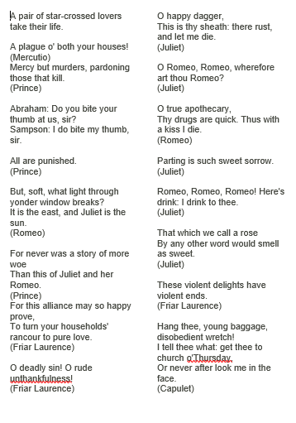
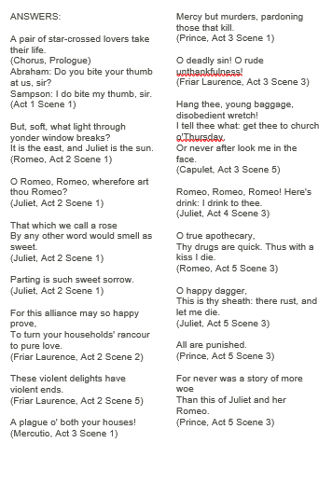
OR…
Put the quotations in the order they appear in the play

Slide 29
Why would Shakespeare choose to ‘kill’ Juliet last?

Slide 30
How is the structure important?
The most important structural device in "Romeo and Juliet" is juxtaposition. Shakespeare repeatedly puts two different people or actions or words side by side to heighten the differences between them, right from the Prologue. There is a number of references to couples and doubles from the start, highlighting that though there are “two households both alike in dignity”, there is an “ancient grudge” which will break to “new mutiny” – there is a conflict between the two families that will end in tragedy. Revealing this from the opening means that the audience is invested in understanding the reasons for the conflict from the outset until the inevitable deaths of the protagonists at the end.
Shakespeare uses foil characters to point out the differences between them. One example of this is when he uses Rosaline as a foil character to compare to Juliet. The first thing you see when Rosaline is compared to Juliet is that Juliet is extremely immature. To prove Juliet's immaturity is when she is talking about not marrying if she can't be married to Romeo. This is an immature thought because she is acting similar to a child trying to get whatever it wants.
Shakespeare also places contrasting actions side by side to heighten tension in conflicts and to move the plot along. One example of this is Tybalt angered by the Montague presence at the Capulet party and the joyful meeting of the two lovers in Act 1 Scene 5. Another major example of this is when it makes the transaction from Romeo and Juliet's graceful marriage to the disturbing scene of Tybalt's death. "Tybalt, the reason that I have to love thee Doth much excuse the appertaining rage" (Act 3 Scene 1) This quote is said by Romeo to Tybalt right before there brawl occurs. Romeo is telling Tybalt that they shouldn't be fighting because they are now relatives; however Tybalt thinks Romeo is mocking him. Another example is Juliet's wedding turning into a funeral over night. This not only brings the play from happiness and joy to depression and sadness, but it also moves the plot along.
Shakespeare even uses contrast in words and images to point out differences. An instance that this is used is in Act 4 Scene 5 when Capulet describes Juliet's wedding to her funeral. "Turn from their office to black funeral; Our instruments to melancholy bells." This quote is Capulet changing all of the festive wedding materials and plans to gloomy funeral plans..
Shakespeare’s use of juxtaposition highlights the conflict in society that exists in fictional Verona and also may reflect the societal issues in Elizabethan lives, where religion and theatre (Shakespeare’s faith and love) were also a cause for contrast and conflict and were not comfortably allowed to co-exist.

Slide 31
Summarise
What do you understand from the short essay?
What have you learnt about structure in the play today?

Slide 33
Do it now:
How many characters from Romeo and Juliet can you list?
Challenge: include key quotations for each character

Slide 34
LI: To be able to identify and comment on the writer’s choices in the play
L3+ – Make basic references, some quotations
L5+ – Make clear references, range of quotations
L7+ - Make developed references and show knowledge of pertinent quotations
CHARACTERISATION
THEME
PLOT
SETTING

Slide 35
Lady Montague
Lady Capulet
Paris
Nurse
Romeo
Mercutio
Tybalt
Married
Capulet
Friar John
Juliet
Friar Lawrence
Benvolio
Montague

Slide 36
Montague, Capulet or neutral?
Capulet
Montague
Romeo
Juliet
Lady Montague
Friar Lawrence
The Nurse
Montague
Tybalt
Mercutio
Lady Capulet
Paris
Benvolio
Old Capulet

Slide 37
Planning for themes
Who would you link to each theme and why?

Slide 39
Romeo – a tragic hero?

Slide 40
Do it now:
Can you recall the meaning of the following words?
OXYMORON UNREQUITED PROTAGONIST
Challenge: Who is the link?

Slide 41
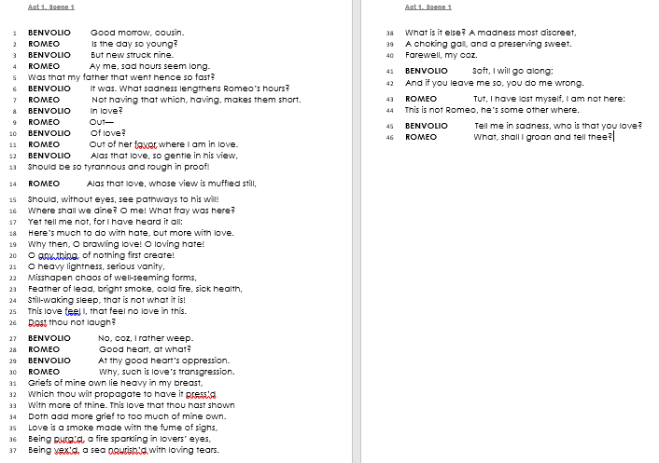
Answer the following in as much detail as you can:
What is happening in the extract?
What are the feelings here?
Do you think that Romeo is truly in love with Rosalind? Make reference to the text in your answer.
Can you comment on how Shakespeare uses language to express the themes of conflict and love?

Slide 42
Do you feel sympathy for Romeo? Why or why not?
What is Romeo’s tragic flaw/harmartia?

Slide 44
Mercutio and male attitudes
What can you remember about the fight scene?

Slide 45
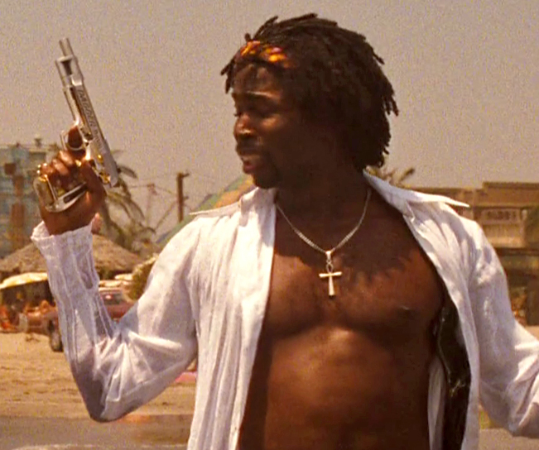
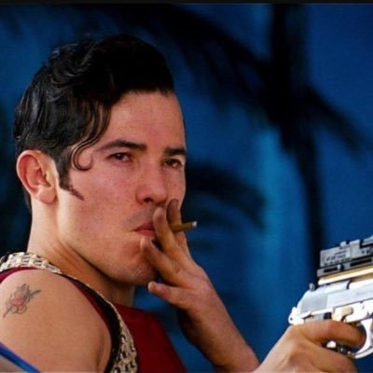
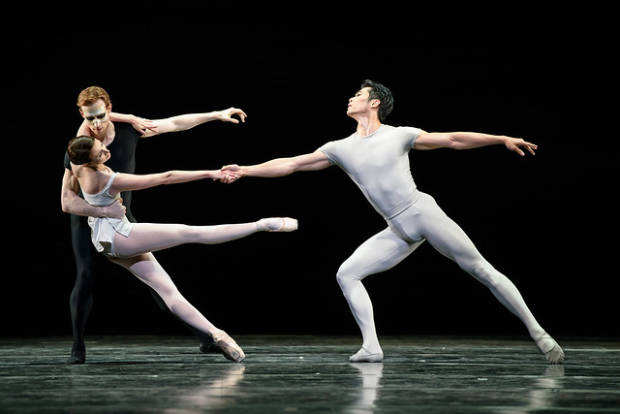
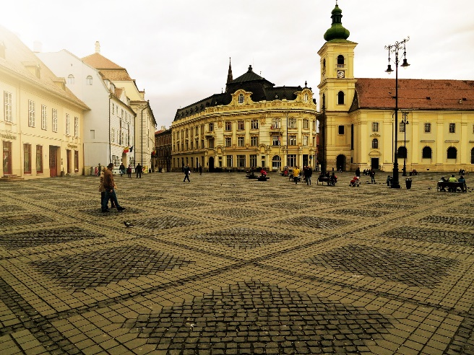
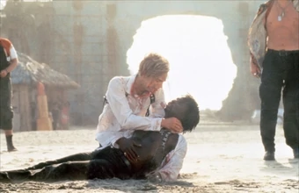
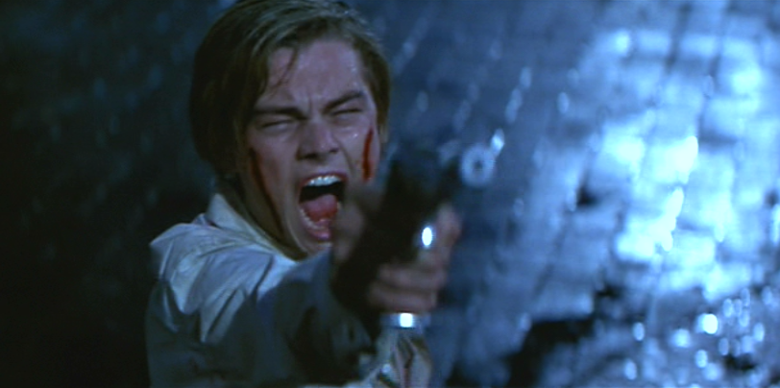
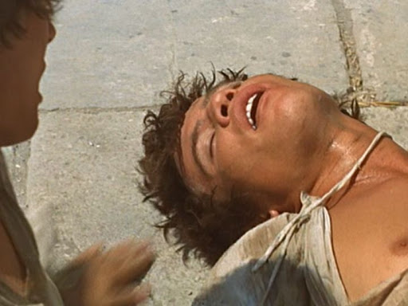
Re-Cap: Act 3 Scene 1

Slide 46
What can you remember about Mercutio?

Slide 47
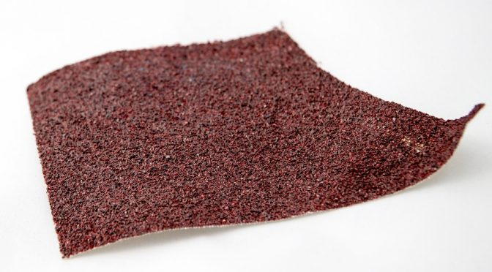
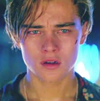
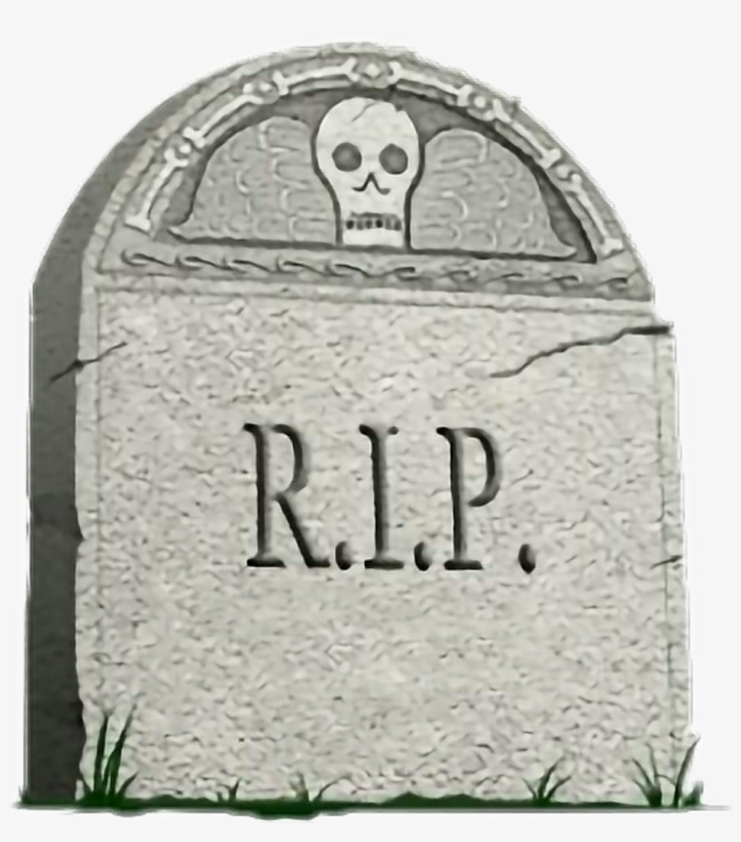
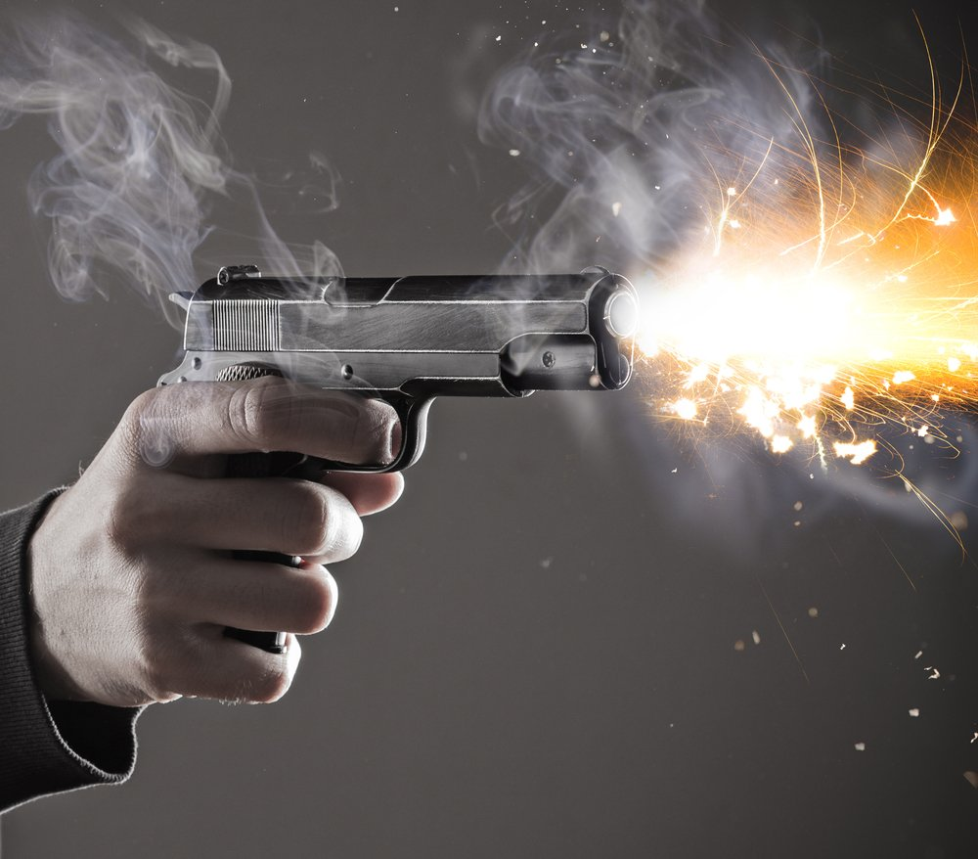
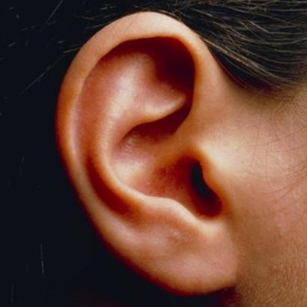
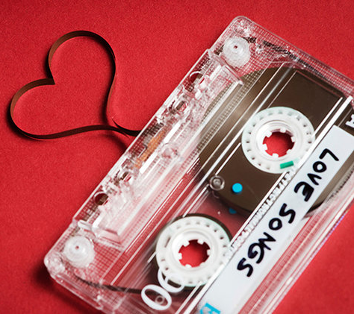
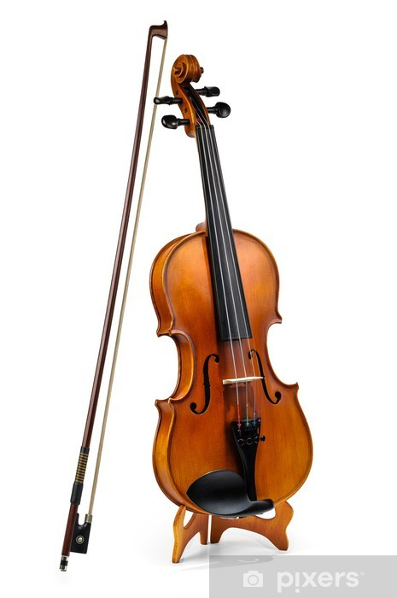
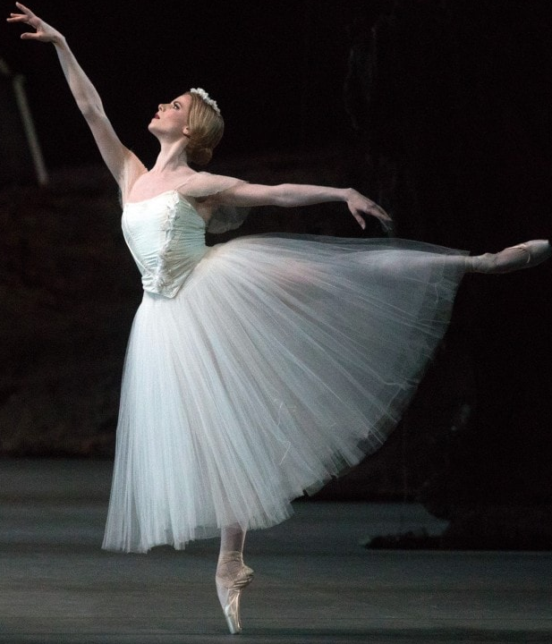
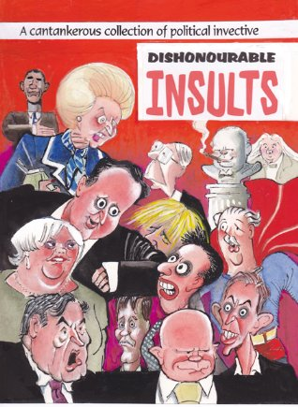
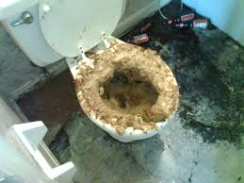
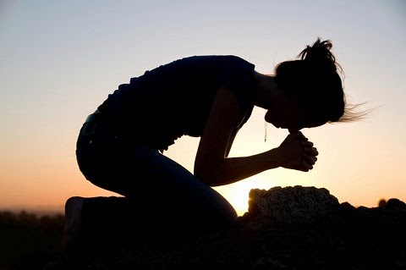
1.
2.
3.
4.
5.

Slide 48
1. ‘If love be rough with you, be rough with love;
Prick love for pricking, and you beat love down’ [1.4]
2. ‘Alas poor Romeo! he is already dead; … shot through the ear with a love-song’ [2.4]
3. ‘And but one word with one of us? couple it with
something; make it a word and a blow.’ [3.1]
4. ‘here's my fiddlestick; here's that shall
make you dance’ [3.1]
5. ‘O calm, dishonourable, vile submission! [3.1]

Slide 49
1. ‘If love be rough with you, be rough with love;
Prick love for pricking, and you beat love down’ [1.4]
Write down as much as you can remember on your white boards!
Mercutio offers direct, unromantic advice – he sees love as a battleground and mostly about sex.
The repetition of words emphasises the connections between love and violence: to Mercutio, they’re basically the same thing.
The statement establishes Mercutio near the start of the play as strong-willed, witty and pragmatic.

Slide 50
2. ‘Alas poor Romeo! he is already dead…shot through the ear with a love-song’ [2.4]
Write down as much as you can remember on your white boards!
Although Mercutio is joking, he establishes a link between love and death here which recurs throughout the play: to him falling in love is like dying.
Mercutio’s ironic tone and attitude to love has already been established – here he pushes it further with huge exaggeration.
There is foreshadowing in this quotation in reference to Romeo being ‘already dead’. Mercutio subverts typical views on hearing love songs and suggests it only brings pain.

Slide 51
3. ‘And but one word with one of us? couple it with
something; make it a word and a blow.’
Write down as much as you can remember on your white boards!
repetition and inversion: once again, Mercutio repeats words he has already used in order to play with them and subvert their meaning
‘couple’ – again, Mercutio uses a word suggestive of sex but links it to violence: he is challenging Tybalt to fight him
‘a word and a blow’: Mercutio uses language in an aggressive, challenging way – he wants to provoke Tybalt and turn words into actions. To him, violence is just more playfulness.

Slide 52
4. ‘here's my fiddlestick; here's that shall make you dance’ [3.1]
Write down as much as you can remember on your white boards!
When Mercutio makes this threat/challenge, he seems in control of the situation – he will ‘make [Tybalt] dance’
‘fiddlestick’ – Mercutio offers to fight Tybalt, but does it as though he is offering to ‘dance’: the is playful suggestion tells us he does not take the threat of violence very seriously – he wants to seem brave and unthreatened
‘fiddlestick’ literally refers to Mercutio’s sword, so it also suggests the male member and is a challenge to Tybalt’s masculinity.

Slide 53
5. ‘O calm, dishonourable, vile submission! [3.1]
Write down as much as you can remember on your white boards!
Challenge:
Can you remember what use of the ‘o’ is called?
‘calm’ – Mercutio cannot believe Romeo’s reaction. He feels that it is unmanly, and opposite to how Romeo normally behaves
‘dishonourable’ – true men fight without caring about the consequences. Romeo has already lost some manliness by forever falling in love and now he has lost it all by declining the challenge of Tybalt.
‘submission’ – Romeo is giving up and Mercutio sees this as a defeat to their enemies. He is brave to the point of being reckless - but this will shortly result in his death.

Slide 54
Starting with this extract, how does Shakespeare present Mercutio and male attitudes to violence?
TYBALT Follow me close, for I will speak to them.
Gentlemen, good den: a word with one of you.
MERCUTIO And but one word with one of us? couple it with
something; make it a word and a blow.
TYBALT You shall find me apt enough to that, sir, an you
will give me occasion.
MERCUTIO Could you not take some occasion without giving?
TYBALT Mercutio, thou consort'st with Romeo,--
MERCUTIO Consort! what, dost thou make us minstrels? an
thou make minstrels of us, look to hear nothing but
discords: here's my fiddlestick; here's that shall
make you dance. 'Zounds, consort!
BENVOLIO We talk here in the public haunt of men:
Either withdraw unto some private place,
And reason coldly of your grievances,
Or else depart; here all eyes gaze on us.
MERCUTIO
Men's eyes were made to look, and let them gaze;
I will not budge for no man's pleasure, I.
In this scene, Mercutio and Benvolio have encountered Tybalt and some other Capulets in a public square. Mercutio challenges Tybalt.
TASK: highlight three quotations that you would use to answer this question

Slide 55
Starting with this extract, how does Shakespeare present Mercutio and male attitudes to violence?
Write about how Shakespeare presents Mercutio and his attitudes in this extract
Write about how Shakespeare presents Mercutio and his attitudes in the play as a whole
What points can you make about Mercutio that will help you answer the question?
Extract
Provocative and challenging – looking for a fight
Playful and witty, even in a serious, dangerous situation
Arrogant and self-obsessed, looking for attention
Whole play
Seeks excitement and thrills – not concerned about danger
Contemptuous of love - thinks it’s just sex dressed up as something more
Sees male honour as based around violence and more important than being safe
Makes connections between love and violence – sees love as more of a danger to men

Slide 56
Starting with this extract, how does Shakespeare present Mercutio and male attitudes to violence?
Write about how Shakespeare presents Mercutio and his attitudes in this extract
Write about how Shakespeare presents Mercutio and his attitudes in the play as a whole
Writing a Thesis – an introduction where you set out your argument.
Shakespeare presents Mercutio as a cynical, wilful and reckless character who is a contrast to Romeo. He shows his wit and attention-seeking throughout the, play right up and even including the moment of his death, and offers comments on love which show how differently he views it to either Romeo or Juliet. His death is a perhaps inevitable consequence of his attitude that being involved in violence is part of a male code of honour where backing down is a disgrace, however dangerous a situation it puts you in. It is love that Mercutio sees as the true danger to men’s honour and status.

Slide 57
Starting with this extract, how does Shakespeare present Mercutio and male attitudes to violence?
Write about how Shakespeare presents Mercutio and his attitudes in this extract
Write about how Shakespeare presents Mercutio and his attitudes in the play as a whole
Shakespeare presents Mercutio as....
In the play when…
Mercutio says that…
Shakespeare makes Mercutio…
Shakespeare’s use of…
The way that Mercutio …
This creates the effect of…
This suggests that… It could also show…
Shakespeare wants Mercutio to be seen as…
Shakespeare wants his audience to think that…

Slide 58
Re-Cap: True or False
1. Mercutio thinks romantic love is a great thing.
2. Shakespeare presents Mercutio as a character who is playful in his words and actions.
3. Mercutio is keen to stand up for Romeo’s reputation.
4. Mercutio sees love very differently to most of the other characters in the play.
5. Mercutio is the most spontaneous Montague.

Slide 59
LI: To be able to identify and comment on the writer’s choices in the play
L3+ – Make basic references, some quotations
L5+ – Make clear references, range of quotations
L7+ - Make developed references and show knowledge of pertinent quotations
CHARACTERISATION
THEME
PLOT
SETTING

Slide 60
Do it now:
What do you know about answering exam style questions?
Challenge: What does each AO cover in Literature (AO1, 2, 3)?

Slide 61
What do you know about life in Shakespeare’s time?
Prompts:
Religion/ beliefs?
Social order?

Slide 62
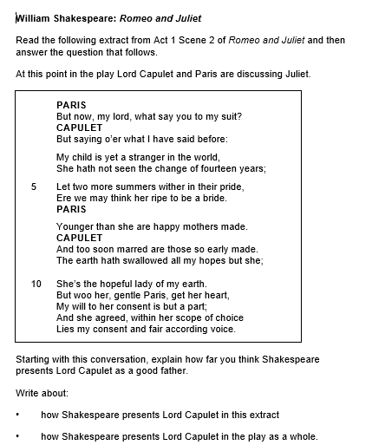
With your teacher, go through the Exampro information about how to answer an exam style question.
What are the examiners looking for?
What makes a good answer?

Slide 63
Extension: How does the later presentation of Lord Capulet show conflict?
Look at 3:5

Slide 65
Conflict in R&J
BENVOLIO I do but keep the peace: put up thy sword, Or manage it to part these men with me. TYBALT 5 What, drawn, and talk of peace! I hate the word, As I hate hell, all Montagues, and thee: Have at thee, coward! They fight Enter, several of both houses, who join the fray; then enter Citizens, with clubs First Citizen 10 Clubs, bills, and partisans! strike! beat them down! Down with the Capulets! down with the Montagues! Enter CAPULET in his gown, and LADY CAPULET CAPULET What noise is this? Give me my long sword, ho! LADY CAPULET A crutch, a crutch! why call you for a sword? CAPULET 15 My sword, I say! Old Montague is come, And flourishes his blade in spite of me. Enter MONTAGUE and LADY MONTAGUE MONTAGUE Thou villain Capulet,--Hold me not, let me go. LADY MONTAGUE Thou shalt not stir a foot to seek a foe.
Romeo and Juliet
Read this extract from Act 1 Scene 1 of Romeo and Juliet and then answer the question that follows.
At this point in the play the Capulets and Montagues have begun fighting in the streets
Starting with this extract, explore how Shakespeare presents conflict.
Write about:
• how Shakespeare presents conflict in this extract
• how Shakespeare presents conflict in the play as a whole.
[30 marks]
AO4 [4 marks]

