Slide 1
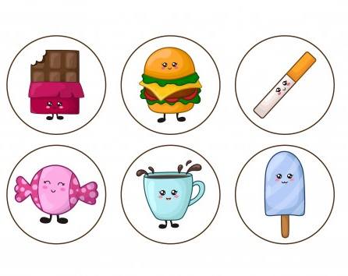
LI: Hygiene & Health
ANAGRAMS
1.apos
2.moospah
3.ahed cile
4.tdeodaorn
5.yobd urood
6.abd eatrbh
I understand the ways in which diet, exercise, hygiene and sleep contribute to being healthy
To understand how important personal hygiene is and how to achieve it

Slide 2
Soap
Shampoo
Head lice
Deodorant
Body odour
Bad breath
Task
What is the message from these images?
By cutting out excess sugar from your diet some of the benefits you will get are:
Healthier teeth
More energy
Better concentration
Water is free
Milk builds strong bones
Notes:
TEACHER NOTES & IDEAS

Slide 3
Brain Pop – Explains Hygiene
Play video
PERSONAL HYGIENE

Slide 4
Place the following activities in the correct column
Wash face
Cleanse your face
Floss your teeth
Change bed sheets
Brush teeth
Wash genitals
Cut toe nails
Wash feet
Wash hair
Wash clothes
Wash hands
Wear clean underwear
Wash armpits
More Than Once A Day
Every Day
Every Other Day
Every Week
Every Two Weeks
Extension
Think of even more ways you should stay clean
Explain why it is important to stay clean

Slide 5
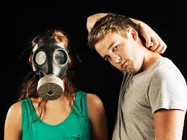
What is B.O.?
Unpleasant odour produced by bacteria reacting with sweat on the skin
Avoid it by keeping yourself clean with a particular focus on areas that sweat the most (Feat, Armpits and Genitals)
Change clothes on a regular basis
Washing clothes regularly
Using anti-perspirants - Reduces the amount of sweat your body produces
Deodorants – Masks the smells your body make
washing hands with soap and water and using a tissue to prevent germs spreading
Hormonal changes can lead to increased oil production – this can clog your pores and cause spots and irritation to your skin. (Try to keep your skin clean and clear and add this into your daily routine).

Slide 6
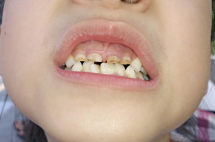
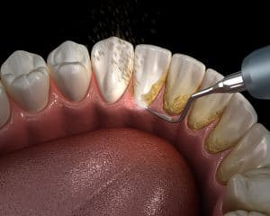
What happens when you don’t brush your teeth regularly?
“In less than 24 hours, a plaque biofilm forms on your teeth and gums, which is a layer of bacteria that can cause bad breath, unpleasant tooth discoloration, or worse—gum disease, which causes our gums to bleed and can lead to loss of bone that supports your teeth,”
Plaque is a film of bacteria that coats your teeth if you don't brush them properly. It contributes to gum disease and tooth decay.
Tooth brushing stops plaque building up. Try to make sure you brush every surface of all your teeth.

Slide 7
Mind map how people can keep their teeth healthy
Brush at least twice a day. The best time to brush teeth is after meals. Choose a toothbrush with a small head for better access to back teeth. Soft bristles are kinder on your gums.
Use fluoridated toothpaste. Fluoride helps to harden tooth enamel and reduces your risk of decay. Brush thoroughly. Tooth brushing should take between two and three minutes. Floss your teeth daily. Use a slow and gentle sawing motion. Limit acidic drinks like soft drinks, cordials and fruit juices. Food acids soften tooth material and dissolve the minerals in tooth enamel, causing holes (cavities or caries). In severe cases, teeth may be ‘eaten’ right down to the gum. Limit sugary foods. Bacteria in dental plaque change sugars into acids.
Protect your teeth from injury. Wear a mouthguard or full-face helmet when playing sports.
Try to save a knocked out tooth. If possible, hold the tooth back in place while you seek immediate dental advice. If this is not possible, wrap the tooth in plastic or place it in milk and seek dental advice immediately.
Avoid using your teeth for anything other than chewing food. If you use them to crack nuts, remove bottle tops or rip open packaging, you risk chipping or even breaking your teeth.
See your dentist for regular check-ups. You should also visit your dentist if you have a dental problem such as a toothache or bleeding gums.

Slide 8
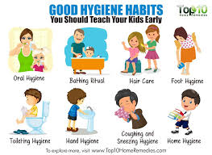
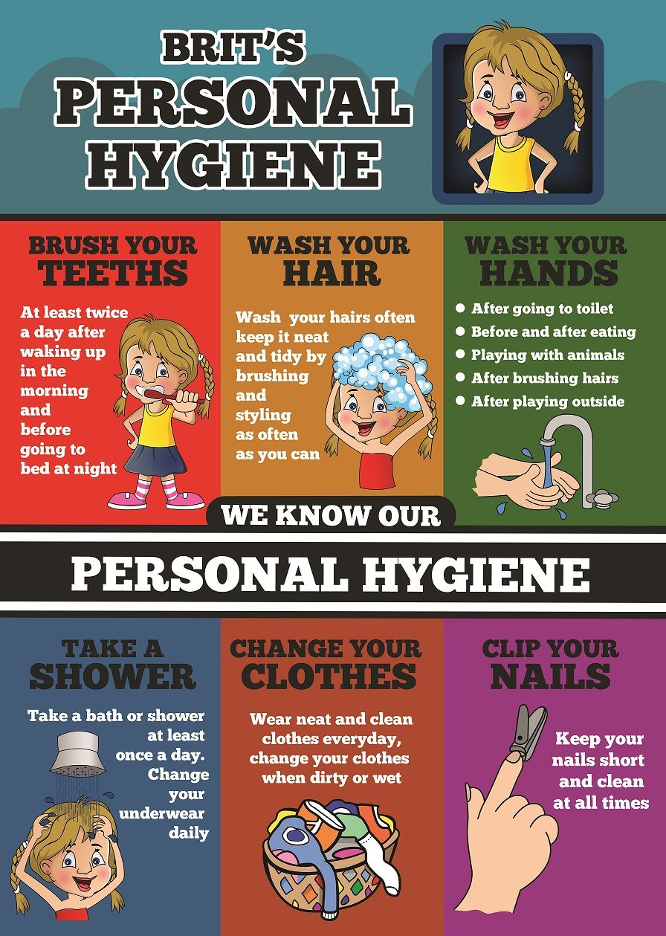
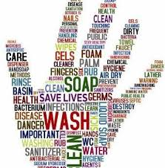
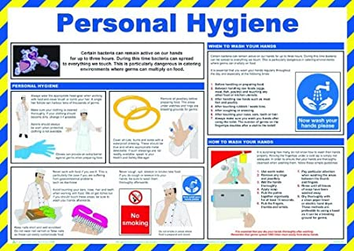
Task
Create a poster or leaflet about the importance of good hygiene. Use words and images.

Slide 9
1
2
3
Precious has noticed that her skin has been developing more and more spots. She tries to cover them up with make up so nobody makes comments. This is becoming harder to do.
Sarah has noticed more of her hair coming out when brushing and that it is becoming quite greasy on a regular basis.
Farooq has noticed that when he finishes ballet club at lunchtime he can be quite smelly for his afternoon lessons and develops sweat patches under the arms
4
Adam has recently overheard comments from other students whispering about how his breath smells quite bad
Task
Pick a scenario and demonstrate you knowledge of the topic by giving this young person good advice about what they could do.

Slide 10
WHAT DO YOU THINK?
“Girls keep themselves more clean than boys”

Slide 11
Confidence Checker
AFTER THE LEARNING | 1 | 2 | 3 | 4 | 5 | 6 | 7 | 8 | 9 | 10
I understand the causes of body odour and how to prevent it
I can explain how personal hygiene links to a healthy body
I understand how to achieve high standards of personal hygiene
Complete the confidence checker of where you think you are at for this lesson (Discussion or complete sheet)
3 Minutes
Notes:
TEACHER NOTES & IDEAS
This could be done by writing a number down in the books – Compare to the start of the lesson
Show of fingers in the air or use Red Amber Green Cards
Quick Partner Discussion & reflect on before the lesson and progress made
Print off the Assessment Opportunity Sheet – Fill in the Confidence Checker / Compare with the baseline
Author Attribution :https://pixabay.com/en/traffic-lights-traffic-light-phases-2147790/

