Slide 1
Y6 TRANSITION
WELCOME EVENING
MONDAY 6TH JULY

Slide 2
Ofsted Update – Top 5
Teaching: Improve the quality of teaching and learning by understanding the pedagogy around the strategies and ensure that this is delivered consistently in every lesson, every day
Curriculum: Ensure that the curriculum is implemented effectively and appropriately adapted to meet the needs of students, increases their aspirations and removes barriers
Achievement: Improve the outcomes and progress across all key stages, through an effective assessment and feedback cycle
Behaviour: Consistent implementation of the behaviour policy
Attendance: Attendance is everyone's business and should be reinforced at every opportunity, ensuring that we support students to attend
Notes:
HSI slide to update

Slide 3
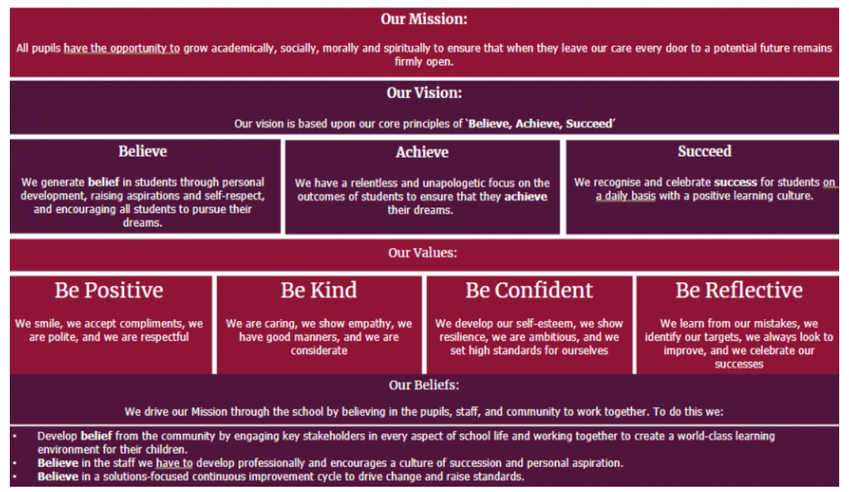
MISSION, VISION AND VALUES
Notes:
CJO

Slide 4
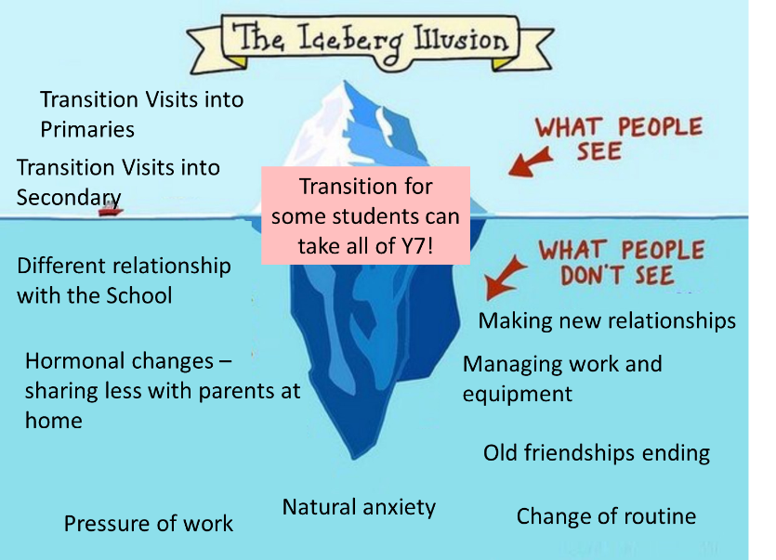
Notes:
CJO

Slide 5
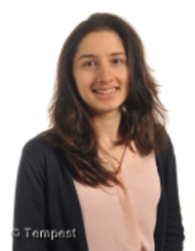
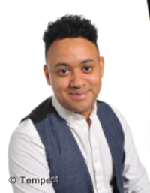

MEET YOUR TUTORS!
Form Tutors
Mrs Gibb
Art
Mr Skelton
DT
Mr Hamer
English
Miss Halmay
Science
Art and Photography
Notes:
HSI slide to update

Slide 6
Role of the form tutor…
Your Form Tutor is the most important person in your child’s school life – they stay with your child throughout their time here.
They are the link between home and school.
Your child will spend time every day with the tutor and will get to know your child really well.
Form Tutors also teach lessons, so aren’t accessible all day, every day – they will take a little while to respond.
A Tutor’s job is to make sure your child is ready to go into lessons and shine!
Notes:
HSI slide to update

Slide 7
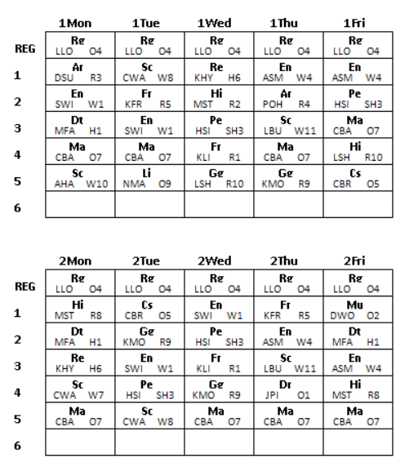
TWO WEEK TIMETABLE
We use a two-week timetable
We start every academic year on a WEEK 1
Lessons won't be at the same time each week i.e. check when your child has PE
Notes:
CJO slide to update

Slide 8
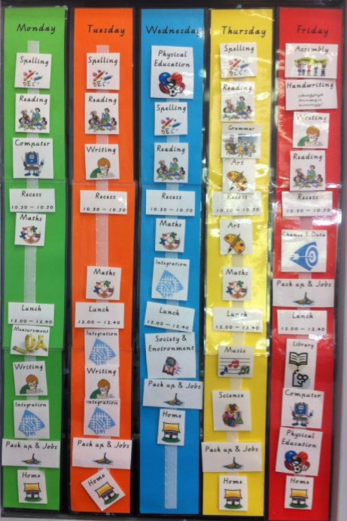
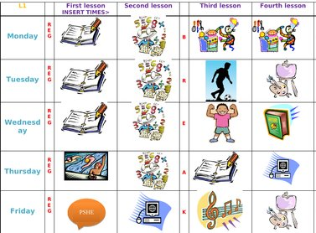
VISUAL TIMETABLES
Notes:
CJO

Slide 9
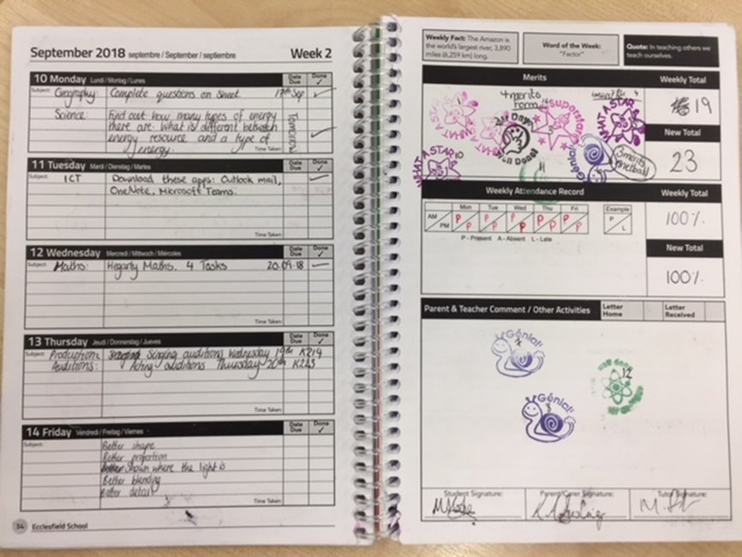
PLANNERS
Used to record homework / collect achievement points / record weekly attendance
Parental notes / teacher notes
Parental signature needed each week
Notes:
CJO

Slide 10


EQUIPMENT
Highlighter
Mini-whiteboard pen
Glue stick
Scientific calculator
Protractor
Reading book
A3 rucksack
Planner – supplied by school
Pencil case
Black pen
Green Pen
Blue Pen
Pencil
Rubber
Ruler
Sharpener
Also useful are:
Colouring pens/pencils
Water bottle
Notes:
JFU slide to update

Slide 11



Positive Climate

Slide 12
Positive climate
PC1 Silent and independent | PC2 One voice, everyone listens. | PC3 Pairs and groups
100% of students are expected to work in silence and remain focused on their task. | 100% of students must be Silent, Sit Up, Tracking the Teacher, nothing in hands with No shouting out when the teacher is talking. . | Students are expected to talk ONLY about things related to the learning taking place, with the person sat next to them.

Slide 13
Attendance. Why Does it MATTER?
% Attendance | Number of days & Learning Missed | Number of Lessons Missed | DfE ‘Category’
100% Attendance | 0 Days Missed | 0 lessons missed | Excellent
95% Attendance | 10 Days of Absence. 2 Weeks of Learning Missed | 60 lessons missed | Good
90% Attendance | 19 Days of Absence. 3 Weeks and 4 Days of Learning Missed | 114 lessons missed | Worrying
85% Attendance | 29 Days of Absence. 5 Weeks and 4 Days of Learning Missed | 174 lessons missed | Serious Concern
80% Attendance | 38 Days of Absence. 7 Weeks and 3 Days of Learning Missed | 228 lessons missed | Serious Concern
75% Attendance | 47 Days of Absence. 9 Weeks and 2 Days of Learning Missed | 282 lessons missed | Serious Concern

Slide 14
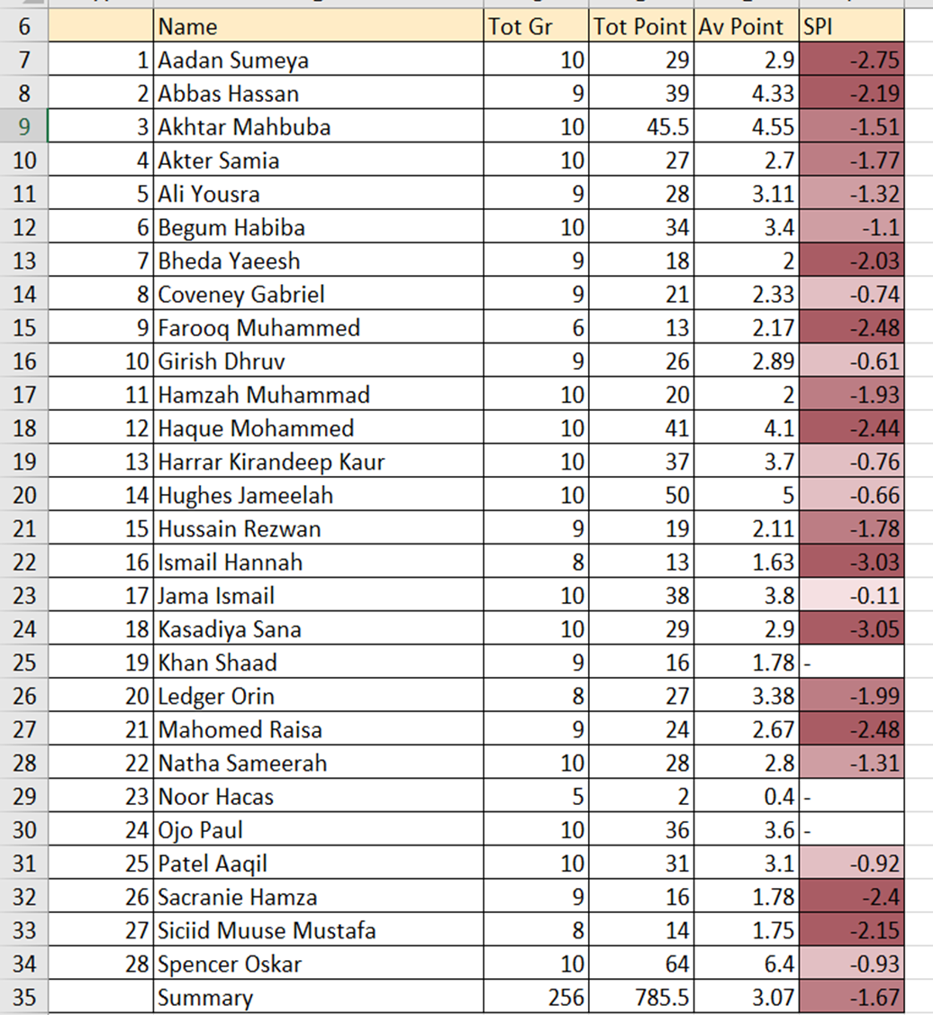
Consequences of PA
You grades will suffer – look over at those pupils last year who ended with <90% (less than)
The Local Authority Officer will eventually prosecute and fine parents whose children are <90%
Students will miss time spent with friends, this helps maintain positive well-being

Slide 15
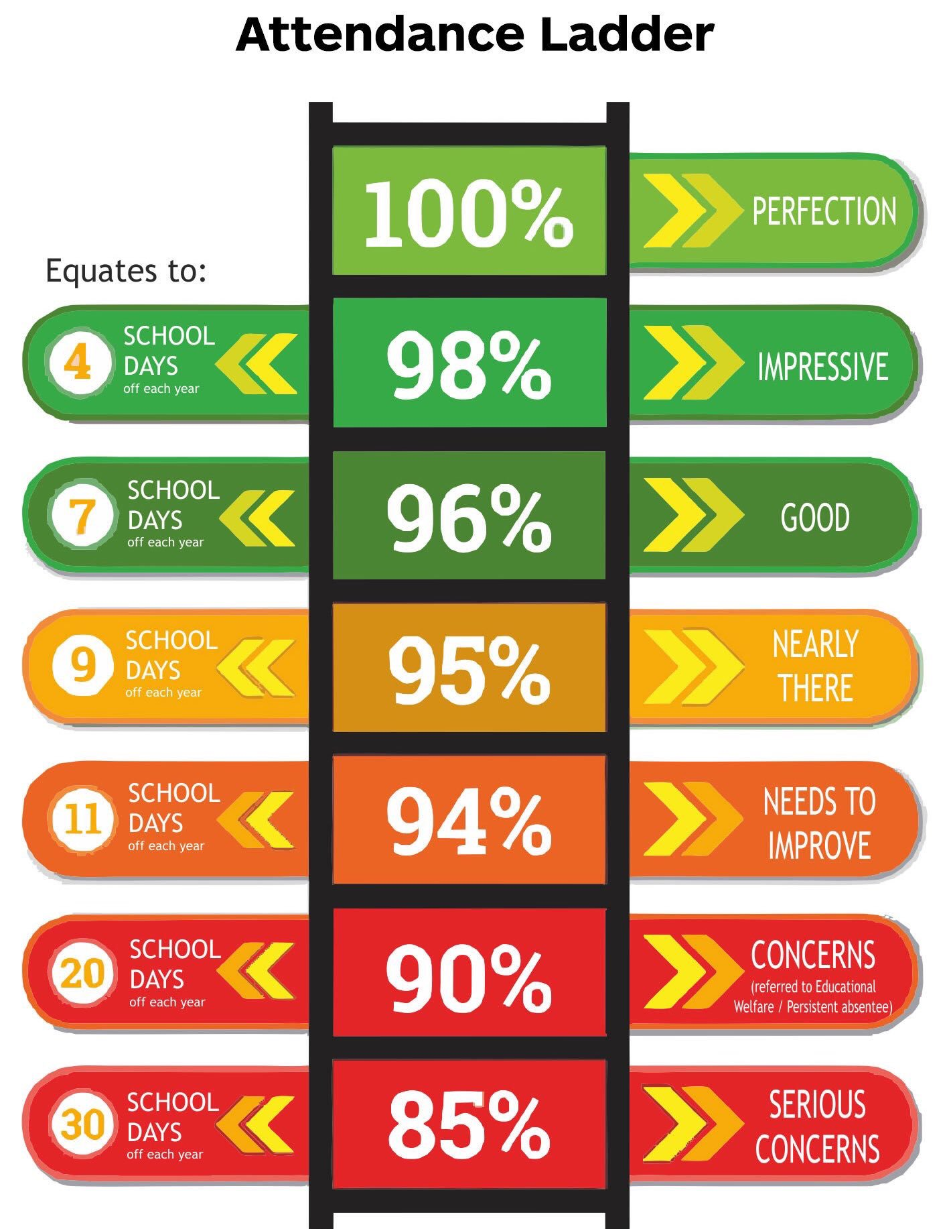
#TeamSHS
TARGET = 96%
WHOLE SCHOOL ATTENDANCE
“Be the BEST you can be…”

Slide 16

SEND – everyone's responsibility
Support when it is needed.
Needs led not diagnosis led.
Short term and longer term.
Pastoral leaders and form tutors first point of contact.
Part of an Inclusion team SENDCO role within that is to: Advise, test, put intervention in place, over-see support.
Parental meeting structures.

Slide 17

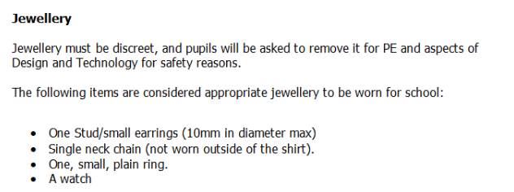
UNIFORM EXPECTATIONS
Notes:
MCL slide to update

Slide 18
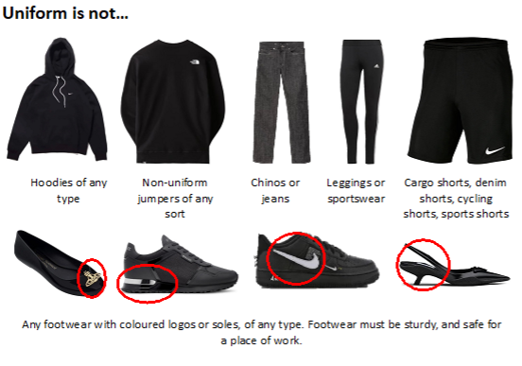
Notes:
MCL slide to update

Slide 19
BEHAVIOUR FRAMEWORK
​ | Outcome​
Verbal/Non-verbal cues​ | Reminder to students​
B1​ | "Warn"​
B2​ | "Move"​
B3​ | "Remove" (on call room that period) + 20 min detention the next day​
B4​ (any others) | Possible Reset Room AM/PM session OR 40 minute detention next day
B4 Internal Truancy​ | 40 min detention the next day 2x B5 in one day - Consequence Room until 4pm the next day
*B6​ | 1-2 days of Reset Room / Possible Step Out​
*B7​ | Suspension​
Notes:
MCL slide to update

Slide 20
MOBILE PHONE FREE SCHOOL
·Phones and earphones are ‘never used, never seen, never heard’ on the school site.
·Students phone must be off and away in their bag BEFORE they come through the front gate into school.
Never used, never seen, never heard on the school site - the use of mobile phones and other smart technology is prohibited for all students at Stocksbridge High School
Any phone, SEEN OR HEARD at any time on the school site will be confiscated (i.e. looking at it, checking it, using it).
It will be logged as a ‘B2 mobile phone violation’
The student will be able to collect their mobile phone from the main school office at the end of the school day (3.10pm).
Students may have phones in their bags, switched off for the duration of the school day. We do not expect to see them or hear them. This includes time in school before the bell goes for Tutor time or after the official school day.
Headphones (in any form) should not be seen at any time in school. If students choose to use headphones when travelling to and from school (please be mindful of personal safety) they must remove them before they enter the school site. If seen in school, they will be confiscated as above.
Notes:
MCL slide to update

Slide 21
Mobile Phones – FAQ’s
What happens if my parents need to get an urgent message to me during the school day? | They can telephone school reception. They will write down the message and pass it on to your Pastoral Leader or on-call so you can take whatever action is needed. Please note this is for emergencies – most students will likely still have a phone in their bag that they can check as they leave the school site at the end of the day for any messages
What happens if I need to phone my parents during the school day? | Students can either go to their Pastoral Leader. Pastoral colleagues will be able to contact parents/carers to share urgent messages. Equally, students can go to Student Reception in an emergency and ask to use the telephone there.
I use my phone instead of wearing a watch – how will I know the time? | There are clocks in most classrooms and spaces. Or ask a teacher! Might be a great opportunity to get a watch this summer.
What happens if I need to let my parents know I have a detention after school? | All after school detentions have a 24hr notice and each day the lists are posted on the reception door / SLT office doors / Pastoral doors. Parents will be made aware of your detention via parent app
Can we use phones in lessons? | Students are not permitted to use their phone in lessons. Teaching staff will ensure they have a system for you to research the internet or use a camera i.e. book out a computer room / use iPad to take photos etc.
Notes:
MCL slide to update

Slide 22
ENRICHMENT – examples from this academic year
Stocksbridge High School - Enrichment Term
 | Monday |  | Tuesday |  | Wednesday |  | Thursday |  | Friday
After school | Gym Sessions LHI | All Years Fitness Suite | Sports Leaders, Links | Y10 TBC | Athletics | All Years Sports Hall | Music Club DWO | Y7 - Y11 O2 | Tennis Club MGR | All years Dance Studio
 | This Girl Can HSI | All Years Sports Hall |  |  | Rubiks Cube & Lego Club JMA/LLO | All Years O4 |  |  | Pod Club (Revision/ Work) | All years Whitwell Library
 | STEM Club CWA/TMA | Y7 - Y10 W7 |  |  | Wellbeing Wednesday PBE/CJA | KS3 HBOUT/H4
 | Cricket | Y7-Y8 Sports Hall
 |  |  |  |  | Gym Sessions MFA | All years Fitness Suite
 |  |  |  |  | Bronze D of E JMI | Y9 R6
Notes:
CJA slide to update

Slide 23
Week 1
Monday |  | Tuesday |  | Wednesday |  | Thursday |  | Friday
Early | Late | Early | Late | Early | Late | Early | Late | Early | Late
Coding Club CBR O5 | Coding Club VFL O5 |  |  | Linguascope Club KFR O3 | Lego Club JMA O4 | Chess Club CBA O7 | Chess Club MGR O7 | KS4 Writing Gp RHO W5 | Calm Colouring CSM O9
Football Y7 CJO MUGA | Football Y7 MCL MUGA | Football Y8 CJO MUGA | Football Y8 MCL MUGA | Football Y9 CJO MUGA | Football Y9 MCL MUGA | Football Y10 CJO MUGA | Football Y10 MCL MUGA | Football Y11 CJO MUGA | Football Y11 MCL MUGA
Football MCL All weather | Football CJO All weather | Football MCL All weather | Football CJO All weather | Football MCL All weather | Football CJO All weather | Football MCL All weather | Football CJO All weather | Football MCL All weather | Football CJO All weather
STEM Girls Club LBU W11 | STEM Girls Club DST W11 | Creative History Club KDI O9 | Y10 Science Support CWA W8 | Pastoral Drop-in LLU O10 |  | Poetry & Performance DHA W1 | KS3 Reading Club HJO W6 | Relax & recharge JSA/HJN/DBR W3 | Sports Journalism Club KMI W4
Colouring Club RHO W5 | LGBTQ+ Club JPI W5 | Reading Club JSH W3 | Brain Teaser Club MWA O4 | Maths SPARX Club NCA O6 | Maths SPARX Club RDR O6 | Crochet Club KLI O8 | Science Drop-in CSI W7 | Podcast & Media Club PSC O2 | Podcast & Media Club PSC O2
Big Screen CJA Hall | Choir DWO O2 | Big Screen CJA Hall | Big Screen CJA Hall | KS4 Book Club RHO W5 | Big Screen CJA Hall | Drama Club LAR O1 | Big Screen CJA Hall | Support Space SBU OLIB | Support Space SBU OLIB
 | Big Screen CJA Hall |  |  | Big Screen CJA Hall |  | Big Screen CJA Hall |  | Big Screen CJA Hall | Big Screen CJA Hall
Sports Hall Football Y8 Lee & Simon | Sports Hall Football Y8 Lee & Simon | Fitness Suite Y10 MFA |  | Sports Hall Football Y7 DSK | Sports Hall Football Y7 DSK | Sports Hall Football Y9 PBA | Sports Hall Football Y9 PBA | Fitness Suite Y9 HSI
Premier League Club RHE O4 | Premier League Club RHE O4 |  |  |  |  | Historical Film Club LSH O4 | Historical Film Club MST O4 | Wildlife film Club AHA O7
 | Eco Club AHA W10 |  |  |  |  | Card Games JMI O9
Fitness Suite Y8 Lee & Simon | Fitness Suite Y8 Lee & Simon |  |  |  |  | Games & Puzzles Club RPA O10 | Games & Puzzles Club LLO O10

Slide 24
Week 2
Monday |  | Tuesday |  | Wednesday |  | Thursday |  | Friday
Early | Late | Early | Late | Early | Late | Early | Late | Early | Late
Coding Club CBR O5 | Coding Club VFL O5 |  | Science Drop-in CSI W7 | Linguascope Club KFR O3 | Lego Club JMA O4 | Chess Club CBA O7 | Chess Club MGR O7 | KS4 Writing Group RHO W5 | Calm Colouring CSM O9
Football CJO MUGA | Football MCL MUGA | Football CJO MUGA | Football MCL MUGA | Football CJO MUGA | Football MCL MUGA | Football CJO MUGA | Football MCL MUGA | Football CJO MUGA | Football MCL MUGA
Football MCL All weather | Football CJO All weather | Football MCL All weather | Football CJO All weather | Football MCL All weather | Football CJO All weather | Football MCL All weather | Football CJO All weather | Football MCL All weather | Football CJO All weather
 | Eco Club AHA W10 |  | Y10 Science Support CWA W8 | Pastoral Drop-in LLU O10 |  | Poetry & Performance DHA W1 |  | Relax & recharge JSA/HJO/DBR W3 | Sports Journalism Club KMI W4
Colouring Club RHO W5 | LGBTQ+ Club JPI W5 | Reading Club JSH W3 | Brain Teaser Club MWA O4 | Maths SPARX Club NCA O6 | Maths SPARX Club RDR O6 | Crochet Club KLI O8 |  | Podcast & Media Club PSC O2 | Podcast & Media Club PSC O2
 | Choir DWO O2 | Big Screen CJA Hall | Big Screen CJA Hall | KS4 Book Club RHO W5 | Big Screen CJA Hall | Drama Club LAR O1 | Big Screen CJA Hall | Support Space SBU OLIB | Support Space SBU OLIB
Big Screen CJA Hall | Big Screen CJA Hall |  |  | Sports Hall Football Y7 JFU |  | Big Screen CJA Hall |  | Big Screen CJA Hall | Big Screen CJA Hall
Sports Hall Football Y8 Lee & Simon | Sports Hall Football Y8 Lee & Simon | Fitness Suite Y10 MFA |  | Sports Hall Football Y7 DSK | Sports Hall Football Y7 DSK | Sports Hall Football Y9 PBA | Sports Hall Football Y9 PBA | Fitness Suite Y9 HSi
Fitness Suite Y8 Lee & Simon | Fitness Suite Y8 Lee & Simon |  |  | Big Screen CJA Hall |  | Historical Film Club LSH O4 | Historical Film Club MST O4 | Wildlife film club AHA O7
 |  |  |  |  |  | Card Games JMI O9
 |  |  |  |  |  | STEM Girls Club LBU W11 | STEM Girls Club DST W11

Slide 25
Online Safety
Online Safety Coordinator – Mr Schuller
Filtering and monitoring checks
  ICT Acceptable Use Policy
Online safety education
  Form Time
  Assemblies
  Computer Science lessons
Sharing information
  Staff
  Students
  Parents
onlinesafety@stocksbridge-mlt.co.uk
Notes:
PSC slide to update

Slide 26

Online Safety
Teaching children to use mobile phones responsibly – time limits, model off phone time etc.
Understand what’s out there and can be accessed free of charge.
Stay savvy and use our online safety expert in school to help.
Support the school’s message re. mobile phone use.
Look out for unhealthy changes towards mobile phones
Notes:
PSC slide to update

Slide 27
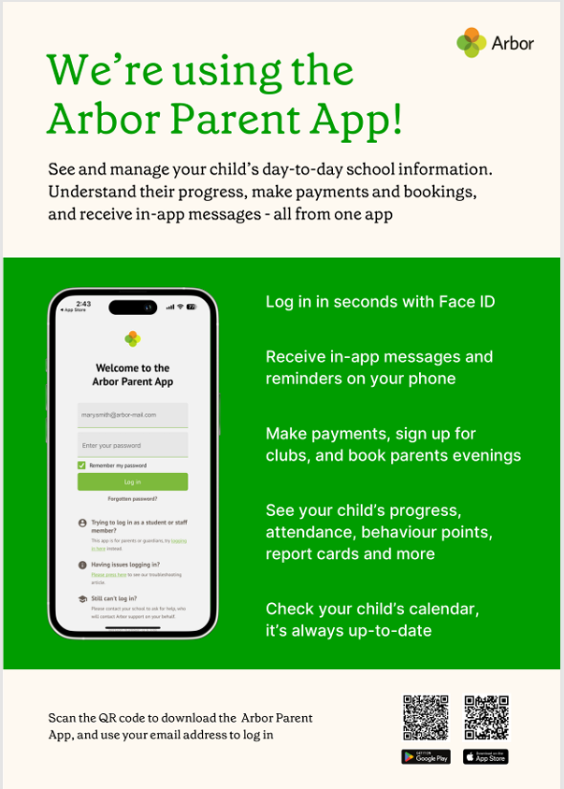
Welcome to Arbor

Slide 28
The Safeguarding Team
Mr Williams – Designated Safeguarding Lead
Mrs Saccomando – Safeguarding Manager, Deputy Safeguarding Lead
Mrs Briggs – Safeguarding and Wellbeing Officer, Deputy Safeguarding Lead
Mr Schuller – Subject Lead for Safeguarding & Inclusion Education, Online Safety Lead & Deputy Safeguarding Lead
Miss Johnson – Deputy Head, Deputy Safeguarding Lead
Mr Clark – Assistant Head, Deputy Safeguarding Lead

Slide 29
Safeguarding HUB
Mrs Saccomando, Mrs Briggs and Mr Schuller are all based in the Safeguarding Hub
Based at the top of the stairs going towards Whitwell and Science/English
Open door policy
Used by staff and students
Listening to all students
Reporting concerns – no matter how small
Following up on concerns

Slide 30
BUS INFORMATION
777 BUS
This route is serviced by 2 x 70 seater coaches both morning and afternoon.
778 BUS
This route has 1x coach servicing this route morning and afternoon.
The 4pm bus that operates on a Mon, Wed, Thurs to accommodate clubs will do one big route starting with the778 route then into 777 or will improvise depending on the students who require this bus.
The fare is £1 each way ( cash only ) unless the student qualifies for a pass please see Sheffield City council website for details.
Please arrive at the bus stop 5 mins before the allocated time.
Notes:
HRA slide to update

Slide 31
BUS INFORMATION - 777
Depart | Stop Name
07:59 | Chapeltown, Ecclesfield Road, adj Park View Road
08:00 | Chapeltown, Lound Side, opp Belmont Avenue
08:02 | Chapeltown, opp Bridge Inn Road
08:05 | High Green, Greengate Lane, nr School Road
08:08 | High Green, Foster Way, nr Cottam Road
08:10 | High Green, Thompson Hill, adj Hague Lane
08:30 | Stocksbridge High School
Notes:
HRA slide to update

Slide 32
BUS INFORMATION – 778
Depart | Arrive | Stop Name
07:40 | 16:30 | Ecclesfield Morrisons supermarket- The common
07:47 | 16:23 | Grenoside Halifax Road-Wheel Lane (The bus can be requested to stop on any stop down Halifax road although these are not timetabled)
07:59 | 16:10 | Middlewood Langsett Avenue
08:02 | 16:07 | Middlewood Middlewood road Winn Gardens
08:06 | 16:03 | Middlewood Middlewood Road North – Stockarth Lane
08:10 | 15:59 | Oughtibridge Langsett road South – Birch House
08:13 | 15:52 | Oughtibridge Langsett road South - Holmesfield road
08:16 | 15:49 | Oughtibridge Langsett road North - Millenium green
08:20 | 15:45 | Wharncliffe Side Main Road -Langsett road North
08:22 | 15:43 | Wharncliffe Side Main road – Green lane
08:25 | 15:40 | Wharncliffe Side Main road – Brightholmlee Lane
08:35 | 15:20 | Stocksbridge High School
Notes:
HRA slide to update

Slide 33
HOW CAN PARENTS HELP?
Help support your child to get organised – but don’t do it for them!​
Label EVERYTHING with their name!​
Ensure they have breakfast before school.​
Encourage them to attend lunch time and after school clubs - they are free!​
Communicate with your child's Tutor.​
Set mini-targets at home and celebrate success.​
Monitor phone use and social media access. – especially now it is banned for U16’s.
Support them in making new friends and don’t panic if their best friend from Y6 moves on.​
Understand that transition can take longer for some children.​
Supporting with homework, isn’t about understanding it – it’s about giving them a space and encouraging them to try to do it. The routine is important.​
We are on the same side, but we won’t always agree.
Notes:
HSI slide to update

Slide 34

KEY DATES
WEDNESDAY 2ND SEPTEMBER: RETURN TO SCHOOL
THURSDAY 17TH SEPTEMBER: Y7 PHOTOS
THURSDAY 1ST OCTOBER: MEET THE TUTOR EVENT
FRIDAY 25TH SEPTEMBER: INSET DAY
THURSDAY 15TH OCTOBER: RESTART THE HEART DAY
FRIDAY 20TH NOVEMBER: CHILDREN IN NEED
FRIDAY 4TH DECEMBER: Y7 WESTON PARK TRIP
FRIDAY 18TH DECEMBER: CHRISTMAS JUMPER DAY
THURSDAY 22ND APRIL: Y7 PARENTS EVENING
Notes:
CJO slide to update

Slide 35
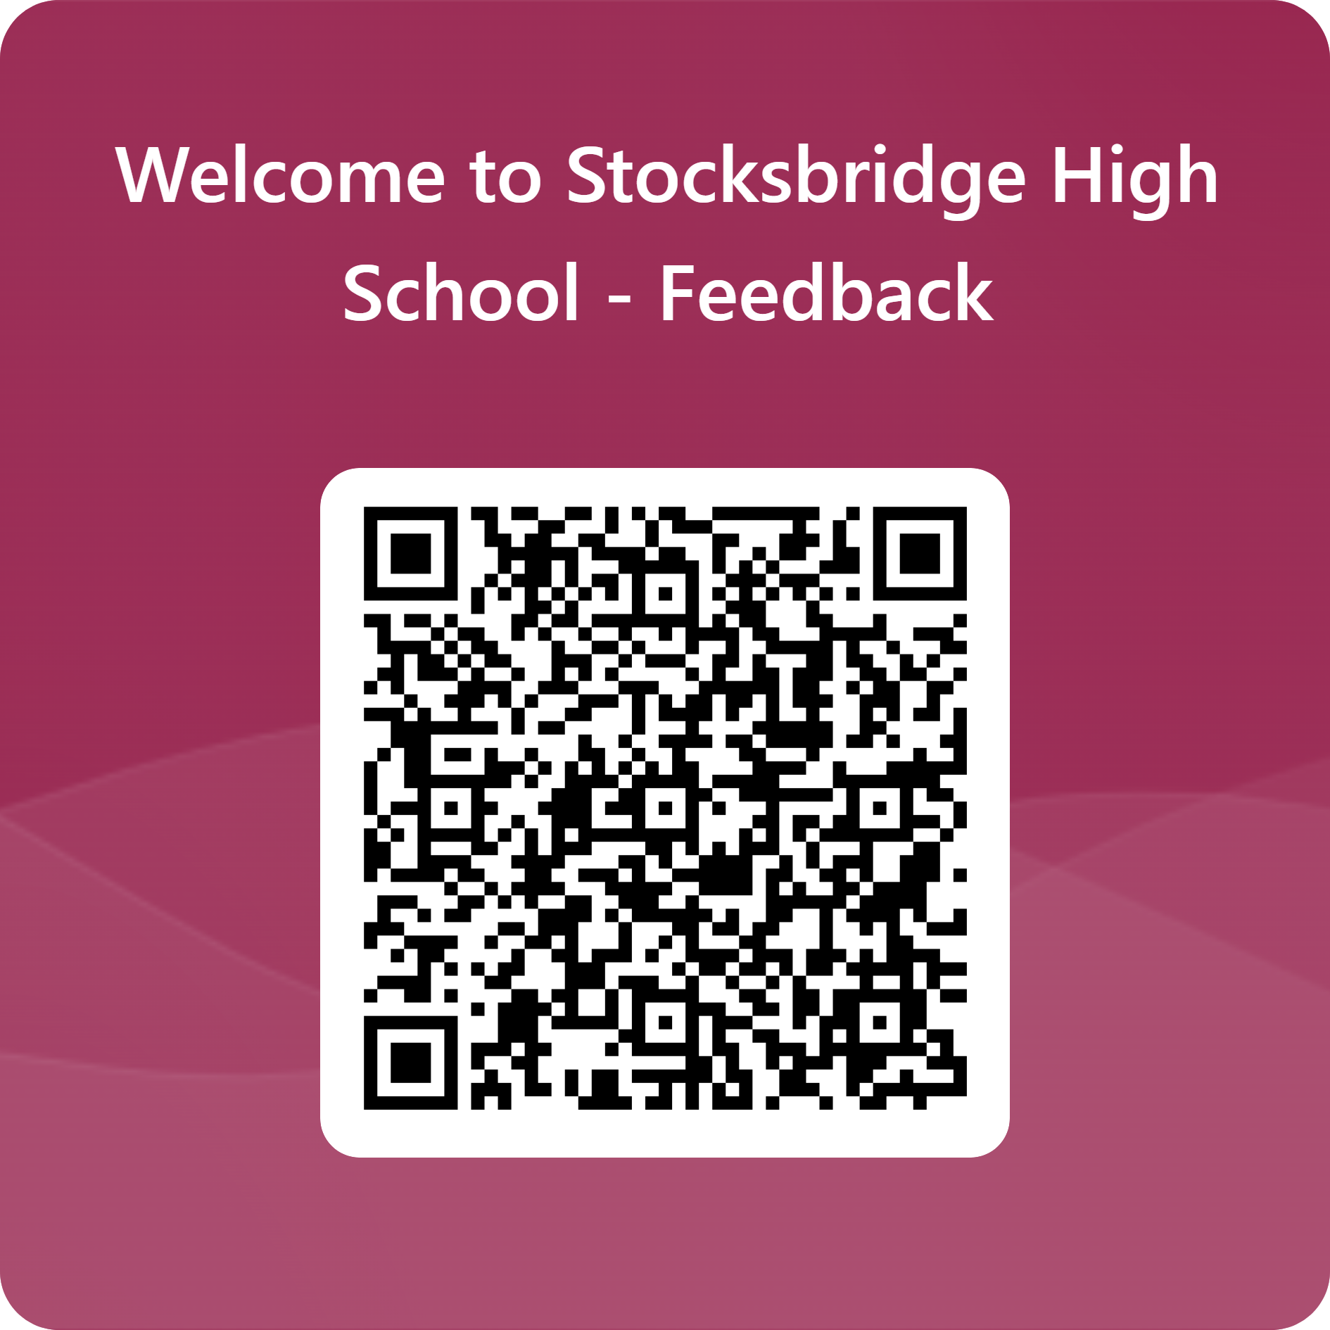
Notes:
HSI slide to update

