Slide 1
Work Experience 2025
Mrs Jackson
Assistant Head, Belonging and Engagement
7 July 2025 – 11 July 2025

Slide 2
Mrs Jackson
Assistant Head, Belonging and Engagement
Date | Event
w/c 13 January 2025 | Launch WEXP Assembly including using Unifrog Letters to parents/carers sent out
Mon 27 January 6pm - 7pm | Parent/carer information event
HT3 and HT4 | Student form time preparation sessions
18 March 2025 | Futures Day – including mock employer interviews
January - July | Finding of placements Placement information inputted into Unifrog
January - July | Checking and administrative management of placements Reminders sent out for H&S information
Friday 6 June 2025 | Deadline of placement information

Slide 3
Introduction to Unifrog and WEXP system

Slide 4
What is Unifrog?
Unifrog believe that destinations - where students end up after school - is even more important than their academic performance. They partner with schools to support students to progress into the best opportunity for them.
Unifrog do this by providing a one-stop-shop where students can explore their interests, then find and successfully apply for their best next-step after school.

Slide 5
Finding placements
Our big tip is around finding high quality placements. Many schools consider that this the hardest part of running a placement programme. It would be great if all schools had an enormous address book of fantastic local employers delighted to host work experience, and also an amazingly well-connected parent body who easily find their children's placements and even pass on keen employers for other children.

Slide 6
It's what not where
What you do on a placement is more important than where you do it. For example, every employer now has to deal with cybersecurity (so you can get first hand experience of this sector almost anywhere), and you can learn about healthcare when work shadowing in lots of non-hospital environments, e.g. at a care home. In an ideal world: students should think carefully and laterally about what they want to learn on their placement, and they should also communicate it in advance to the employer.

Slide 7
Students being proactive
Proactive students can generally secure work placements for themselves. They need to think carefully about what sort of employer they are interested in, do some research online to find contacts, then send emails and make phone calls. Some schools make time in the school day for students to learn how to write a good cold email, and find employer contact details online. This is probably one of the most transferable skills these students will ever learn at school!

Slide 8
Communicating with parents
Most parents will be able to find good placements you if they are motivated to do so. If they are employed, they can contact their own employer, or they can ask a friend’s employer. Many schools now start the process by sending a letter or email to the parents, inviting them to a virtual information evening about placements. You can maximise the chances of being successful by: - Communicating with parents early; - The parents being clear on the benefits to their child of doing a placement; - The parents being clear on the parameters (mainly when the placements should happen and for how long they should last); - The parents being clear on the next steps (i.e., their child needs to iron out the placement details with the employer, and then use the Unifrog placements tool to get things started).

Slide 9
Dealing with the legals 1
Essentially: in most countries, a student on a placement is considered the same as a normal employee, and the employer’s normal policies (i.e. Risk Assessment, Health & Safety, insurance, and data protection) should cover them. The employer should check their documentation to make sure that it is appropriate for having a young person at the workplace.
In terms of who is responsible for what: it's the employer’s job to make sure that they have the right policies in place, and the school needs to take reasonable steps to satisfy themselves that the employer is acting responsibly. On the Unifrog placements tool, we explain to the employer exactly what policies are required, and the employer has to confirm that they meet all these requirements.
Out of an abundance of caution, the system instructs the employer placement lead to email to the school / college placement coordinator a copy of their Risk Assessment and Health & Safety policy if any of these apply: the student has special needs, illnesses or injuries that might affect the placement, it's the employer's first time hosting a placement, or the workplace is above low risk.

Slide 10
Dealing with the legals 2
The placement provider (ie the employer) has primary responsibility for the health and safety of the student;
The school's/college's role is solely to take reasonable steps to satisfy themselves that the employer is acting responsibly;
Young people on placements are considered like normal employees of the host, so a company’s normal Risk Assessment (RA), Health & Safety (HS) and insurance policies are sufficient. The employer just needs to make sure that what they have in place is appropriate for the age of the people hosted on the placement. For example, the RA and H&S policies need to take into account young people who might not be familiar with workplaces.
Parents / guardians of students under 18 need to agree to the student going on a placement.

Slide 11
Safeguarding
The Employer placement lead (and whoever else is directly interacting with the young person on the placement) should be mature in their attitudes and able to establish good professional relationships with young people;
Physical contact should be avoided where possible, with the understanding that sometimes it is unavoidable, for example when it is necessary to show someone how to operate machinery;
If a student doesn't show up to their placement, or they have an accident during the placement, or the student commits a significant act of indiscipline, you must let the School placement coordinator know right away;
If a young person confides to an adult personal information that gives rise to concern for the young person's safety or the safety of others, the adult should:
Be open to listening and be non-judgemental;
Not promise to keep anything secret;
Write down what the young person said in as much detail as they can and as soon as possible pass on the information to the School placement coordinator.

Slide 12
Safeguarding – visits from staff
The short answer is that in-person checks are only necessary in unusual cases. Unfortunately, there is some confusion about this - with incorrect information sometimes being shared!
The school/college's responsibility is to take reasonable steps to assure themselves that the employer is acting responsibly, and that the student will therefore be safe during the placement. If you follow the standard steps on the Unifrog placements tool (doing things like finding out from the employer what the workplace is like, what the overview of the placement is, and asking them about their RA), then for most employers and their workplaces, and for most students, it is not necessary for someone to do an in-person check ahead of a placement happening, or during the placement.
Also, you do not need specific training in Health & Safety to make this judgement.
Someone coordinating placements at a school/college might decide that an in-person check is necessary if the specific workplace, or the specific student, make them think that this would be a good idea (for example, the workplace might involve heavy machinery, or the student might have special needs).

Slide 13
Safeguarding – DBS checks
Schools / colleges should decide whether to check if an adult is barred from working with children based on the specifics of a particular placement.
Normally checking means having the relevant adult do days or enhanced DBS check, including the children's barred list.
A check might be necessary if all 3 of these apply:
The student is likely to ever be on their own with an adult, without a second adult present, and
The student is pre-16 at the end date of the placement, and
The placement will last more than 3 days or runs overnight.
For placements where the student is 16+, the school cannot request a DBS check of the employer

Slide 14
Safeguarding – DBS checks
On the Unifrog Placements tool:
We strongly advise the employer that it's not a good idea for the person working with the young person to be alone with the young person.
If the student is likely to ever be on their own with an adult, without a second adult present, AND the student is pre-16 at the end date of the placement, AND the placement will last more than 3 days, we:
Ask the employer if they can ensure that relevant adults are not barred from working with children, and explain that this normally means that they have had a DBS check
If the employer says ‘no’ to the above, we flag this fact extremely clearly to the school/college placement coordinator, explaining that they should likely refuse permission

Slide 15
Insurance
When people talk about the insurance that is required for placements, they are (or should be!) talking about Employer's Liability Insurance (ELI). This financially safeguards an employer against allegations of injury or illness to employees arising out of their employment, and in so doing it also safeguards employees, because it means that there will be money available should the employee make a successful claim. With a few edge-case exceptions (detailed below), it is a legal requirement for any employer. In the UK and in many other countries, students on a placement are treated as employees of the employer for the purposes of insurance - so it's important that the employer has ELI in place.

Slide 16
Insurance
On the Unifrog Placements tool, for an in-person placement:
If the employer fits into one of the special categories , the tool asks the Employer placement lead what insurance, if any, the employer does have in place
Otherwise the tool asks employers to give details for their Employers' Liability Insurance, including sharing with the school / college a copy of their insurance certificate (even for a normal low risk placement, the UK's Health & Safety Executive recommends that schools / colleges see a copy of the employer's insurance certificate).
Employers upload their insurance certificate straight into the form. If they are blocked from doing this (a rare occurrence normally caused by an employer's firewall) then the form allows for them to email it to the placement coordinator instead.
If the Employers' Liability Insurance will have expired before the end date of the placement (or a day after the start date if the placement is marked as ‘ongoing’), then the Employer placement lead must commit to updating the insurance details before the start of the placement. The system also sends the employer a reminder email to update their insurance details on the day after they've said that their insurance will expire.

Slide 17
Other legalities
GDPR and related data protection law
Risk Assessment
Fire Risk Assessment
Health & Safety policy

Slide 18
10 Huge Benefits of In-Person Work Experience
1. You’ll enter the job market
6. You’ll become familiar with a new industry
2. You get to apply your skills in a new context
7. You’ll build your professional network
3. You’ll gain new skills
8. You might find a career mentor
4. You’ll begin to understand the industry
9. You’ll identify your strengths
5. You get to learn about a new employer
10. You might land your dream job

Slide 19
Other Types of Placement
Virtual placements
Unifrog –
log in and search through the 'Courses' Tool
Springpod
Gain Virtual Work Experience. Earn certificates - 100% free! | Springpod
Speakers4school
Unlock Exciting School Work Experience Opportunities!

Slide 20
cdn.unifrog.org/video/n193u79dee/720.mp4

Slide 21
The Unifrog tools
Access all tools on Unifrog to learn what options are available, access good quality information, and search for opportunities to support your child.
Recording what you’ve done
Searching for opportunities
Drafting application materials
Making applications
Quizzes
Exploring pathways
Interests profile
Careers library
Activities
UK universities
UK Personal Statement
Post 18 Intentions
Personality profile
Subjects library
Skills
US universities
Classes
Locker
Work environments profile
Know-how library
Interactions
European universities
Subject References
Applications list
MOOC
Oxbridge
CV / Resumé
Skills profile
Webinars
Canadian universities
Writing tool
Read, Watch, Listen
Asian universities
Common App Essay
Australasian universities
US recommenders
MidEast and Africa unis
Notes for Reference writers
Irish universities
Special Opportunities
Events

Slide 22
Careers library
Over 1000 career profiles
Presents information from a range of sources, including local and national LMI
Includes qualifications and skills needed, interviews with industry professionals and labour market information
Explores progression opportunities and what a working week really looks like

Slide 23
UK Universities
Students can enter subject of interest and projected grades to see all relevant university courses available in the UK
Rank and filter opportunities by factors like hours of lectures, price of accommodation and graduate job rates
Get direct links to university information pages, with impartial information on courses and institutions
Save unlimited shortlists to refer back to later

Slide 24
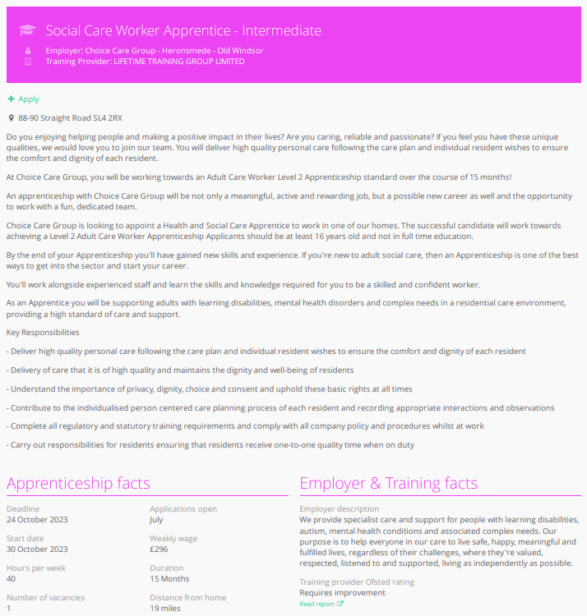
Apprenticeships
Students can find live apprenticeship vacancies
Vacancies are updated daily
Rank and filter opportunities by factors like distance from home, weekly wage and application deadlines
Direct link to the ‘apply’ page
Each apprenticeship vacancy includes practical information about the opportunity, employer and training
Save unlimited shortlists to refer back to later

Slide 25
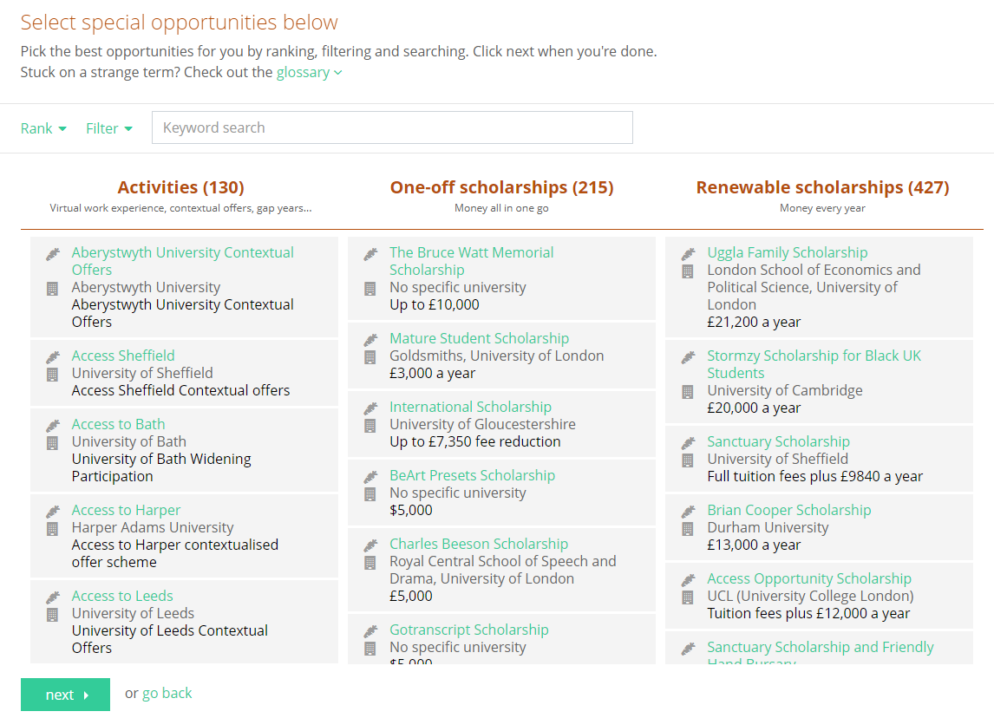
Special Opportunities
Includes £5 million-worth of grants, bursaries, scholarships, contextual offers and extracurricular activities
These can be filtered by circumstances or characteristics, depending on the access requirements of the opportunity
Includes direct links for applying
Unlimited shortlists can be created and referred back to

Slide 26
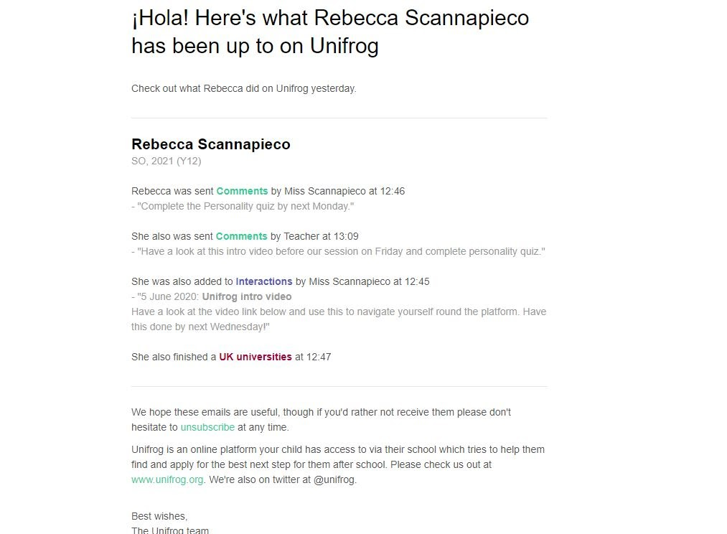
Weekly summary emails
Parents can sign up to receive weekly summary emails
This summary will show you any shortlists your child may have made on the Unifrog platform
It will also detail any interactions logged against your child, such as Careers Fairs taking place or careers interviews coming up
Notes:
Please note that these summary emails will only be sent out to parents if the school links parent accounts.
To do this, please fill in this spreadsheet: https://www.unifrog.org/downloads/update-student-parents.csv?07092022 and send it to the Partner Success Team: info@unifrog.org.

Slide 27
GDPR
GDPR is a regulation in EU law on data protection and privacy for everyone within the European Union and the European Economic Area.
Unifrog takes data security very seriously, and as such, has several features in place to protect school and student data.
We only use EU data centres, have multiple firewalls, layered-access security and more. Information on this can be found at unifrog.org/about#security
Notes:
Unifrog’s privacy policy can be found here: https://www.unifrog.org/privacy-policy
Service terms can be found here: https://www.unifrog.org/website-terms

Slide 28
Other cool stuff
The Unifrog platform contains so much more than what we can show you today, that was just four of their many tools.
So why not see for yourself? Sign up as a student and access the tools in exactly the same way that the students do.
You never know, there might be a new career just around the corner!

Slide 29
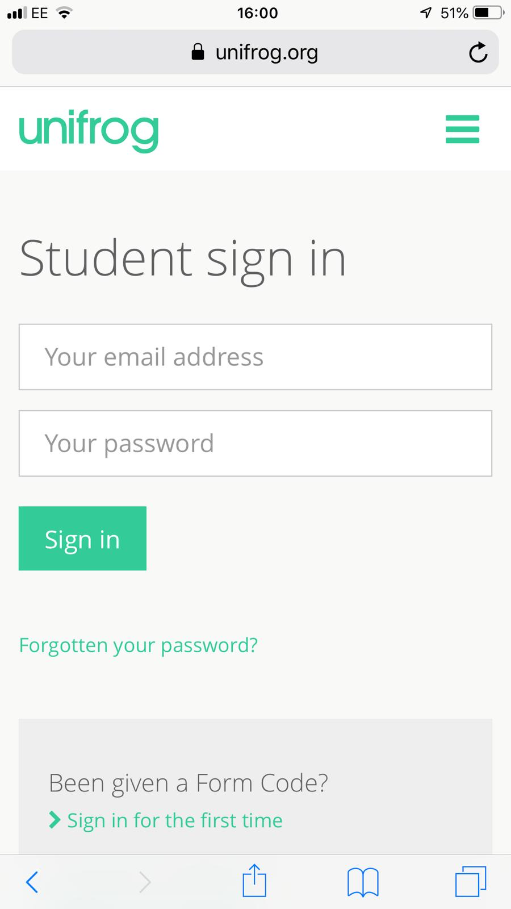
Parents & guardians, get signed up!
Scan this QR code or go to www.unifrog.org/student and click ‘Sign in for the first time’
You’ll be asked for some details and a Sign up Code. This is what you need:
<<SBHSPARENTS>>
After signing up, log into Unifrog using your email address and password via the student sign-in page!

